Slide 1
HMIS Training
DC 103: Youth Entry Exit Workflow

Slide 2
Agenda
HMIS Basics Recap
Introduction to ClientPoint
The Entry/Exit Workflow
What does entry mean for my project type?
Creating a new client
Completing Client Profile information
Creating an entry
Entry Assessment
Rapid Re-housing and Permanent Housing
Housing Move In Date
Annual Assessments
Exiting a client
2020 Data Standards Changes
Common Data Entry Errors
Additional Resources

Slide 3
HMIS Basics Recap
DC’s HMIS
Visibility Basics
Data Security
Notes:
For more information view the DC 100 training

Slide 4
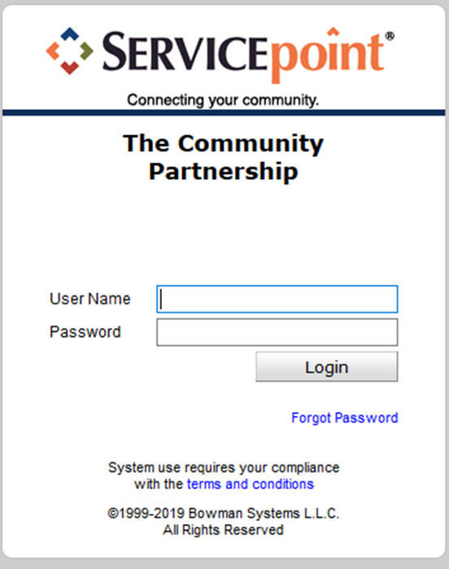
ServicePoint – DC’s HMIS Software

Slide 5
Visibility Basics – Current Structure
DC’s Lead Agency
Agency A
Agency B
Program 1A
Program 2A
Program 1B
Notes:
Now agencies are able to see all of their own information. Only some information is shared across agencies.

Slide 6
HUD UDEs – What’s Shared & What Isn’t
Universal Identifiers (one answer per client record)
Universal Project Stay elements (One or more values per project stay)
Name
Name Data Quality
Social Security Number
Social Security Number Data Quality
Date of Birth
Date of Birth Data Quality
Race
Ethnicity
Gender
Veteran Status
Disabling Condition (Yes/No)
Project Start Date
Project Exit Date
Destination
Relationship to Head of Household
Client Location
Housing Move in Date (for RRH and Permanent Housing projects)
Prior Living Situation
Notes:
The purpose for having these shared vs other data is that these are expected to not change and are used to identify the correct client file. The other data elements are expected to be collected at each project stay and is not necessary for the identification of the correct client file.
In order to share this more detailed information and ROI is needed.

Slide 7
Coming Soon: Universal ROIs
There is not currently a standard ROI for the CoC but that is being worked on.
Once more information is available we will update you all on this new document and the processes involved.

Slide 8
Data Security
Keeping client information safe and secure begins with YOU!
Do not let others log in as you.
Keep your user name and password to yourself.
Do not keep it posted anywhere others can see
Do not leave your computer unattended while logged into ServicePoint.
Do not save your login information with your web browser.
Do not send client identifying information via unencrypted emails (including to the helpdesk!)
Client Identifying information includes:
Name
Date of Birth
Social Security Number
Notes:
Data Security is important!

Slide 9
Logging In
Training site: https://sp5.servicept.com/washdc_demo/
Live site: https://washdc.servicept.com

Slide 10
Logging In
Training site: https://sp5.servicept.com/washdc_demo/
Live site: https://washdc.servicept.com
Forgot your password?
Click here!

Slide 11
System News
We are using System News to alert Users to changes in the system, as well as scheduled system down time.
We will also be populating it with other resources so stay tuned…

Slide 12
Introduction to ClientPoint
ClientPoint is used by most Agencies in order to document program stays, case plans, services provided, and case managers.
The primary method of tracking program stays in ClientPoint is Entry/Exits.

Slide 13
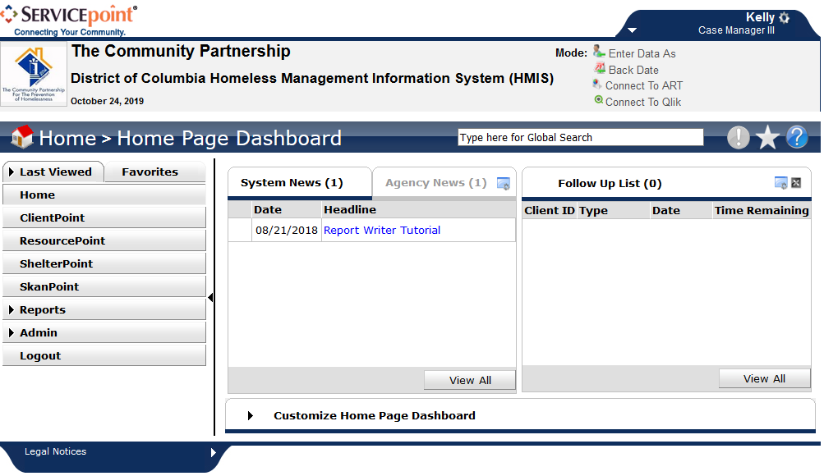

Slide 14
The Entry/Exit Workflow
Tracking clients served by a given provider using Program Entry Date and Program Exit is an Entry/Exit Workflow.
Programs contributing data to the DC HMIS that use an Entry/Exit Workflow include:
Emergency and Temporary Shelters for Families;
Temporary Shelters for Singles;
Transitional Housing Programs for Families and Singles;
Permanent Supportive Housing Programs for Families and Singles; and
Rapid Rehousing Programs for Families and Singles.
If you are unsure which program type you operate, please contact the HMIS Helpdesk.

Slide 15
What does Entry mean for my project type?
Street Outreach:
Date of first contact with the client
Emergency Shelter:
Night the client first stayed in shelter
Transitional Housing:
Date the client moves into the residential project (first night in residence)
Permanent Housing including Rapid Re-housing:
Date client was admitted into project
To be admitted indicates the following factors have been met:
Information provided by the client or from the referral indicates they meet the criteria for admission
The client has indicated they want to be housed in this project
The client is able to access services and housing through the project. The expectation is the project has a housing opening or expects to have on in a reasonably short amount of time
Supportive Services Only, Day Shelters, Homelessness Prevention, Coordinated Entry:
Date the client first began working with the project and generally received the first provision of service.
Notes:
Project Start or Entry means different things for different project types.

Slide 16
Searching for a Client
You will need to search for a client in order to add the client to your program
You can search for the client by name, or if you know the client’s ID #, you can use that.

Slide 17
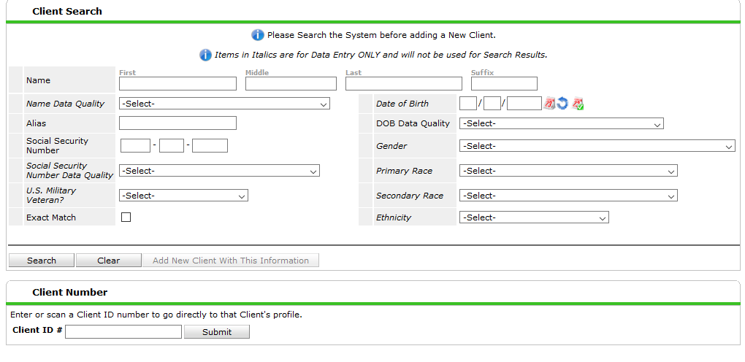

Slide 18
Creating a new client file
If you do not find a client record for the client you are serving, you will need to create a new client record.
This is done from the Search box in ClientPoint.

Slide 19
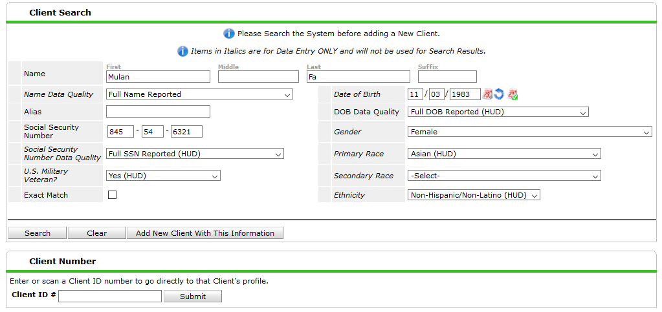
Notes:
You MUST search for the client record before you are able to create a new client record.
You MUST enter all the information indicated BEFORE you click “Add New Client With This Information”

Slide 20
Completing the Client Profile Information
Once in the Client record in ClientPoint, navigate to the Client Profile.
If there is any missing or incorrect information in the Client Record or Client Demographic sections, click the corresponding Edit Pencil(s) to make the necessary changes.

Slide 21
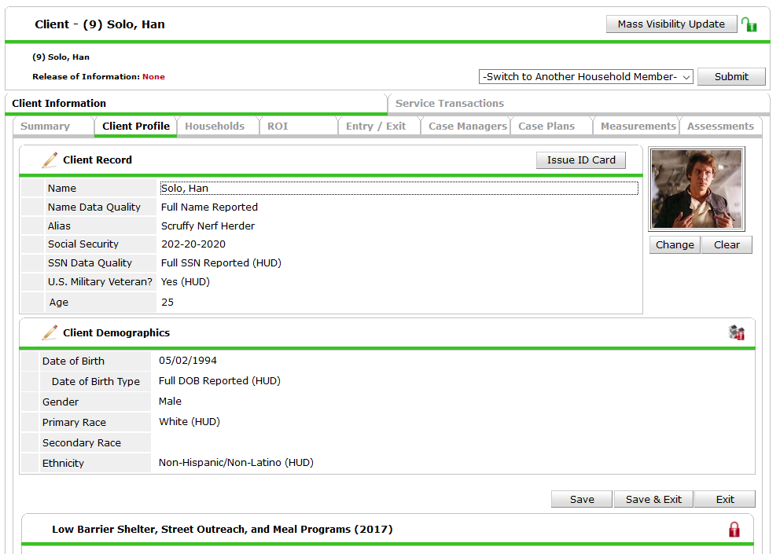

Slide 22
Creating a Household
Often, existing client records are a part of existing households.
Use existing households wherever possible.
If the household does not yet exist, you will need to create a new one.

Slide 23
To create a new Household, navigate to the Household Tab.
Click “Start New Household”

Slide 24
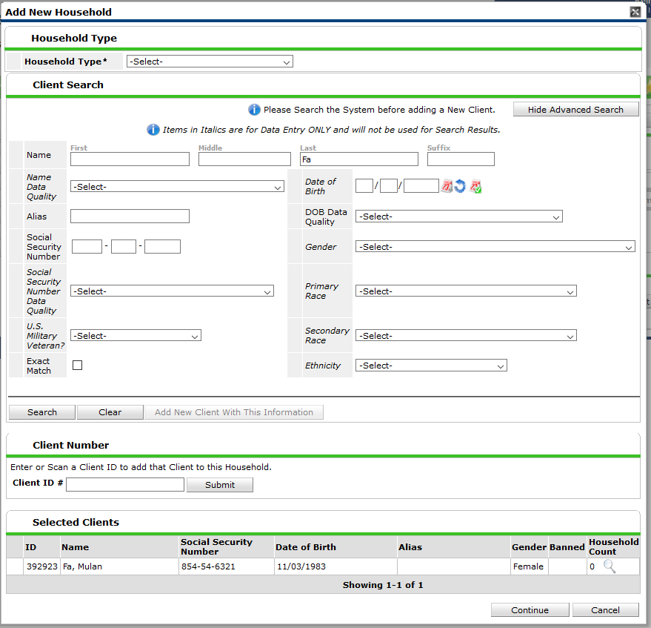
Choose the Household Type
If you know the household member’s HMIS ID#, type it in the Client ID # and click “Submit”
If you do not know the household member’s HMIS ID #, Search for the client

Slide 25
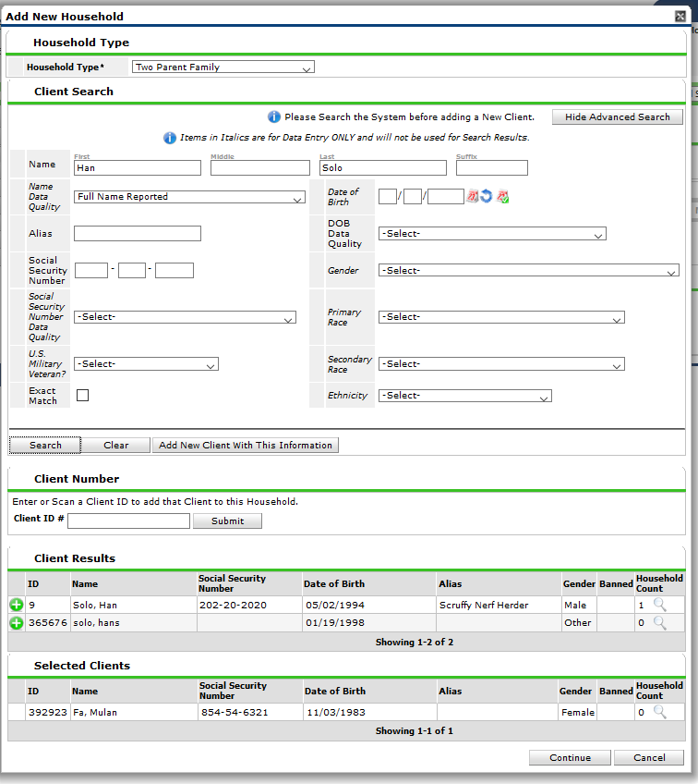
Choose the Household Type
If you know the household member’s HMIS ID#, type it in the Client ID # and click “Submit”
If you do not know the household member’s HMIS ID #, Search for the client
If the client appears in the Client Results Section ensure it is the correct client, and then select the green plus sign to add the client to the household.

Slide 26
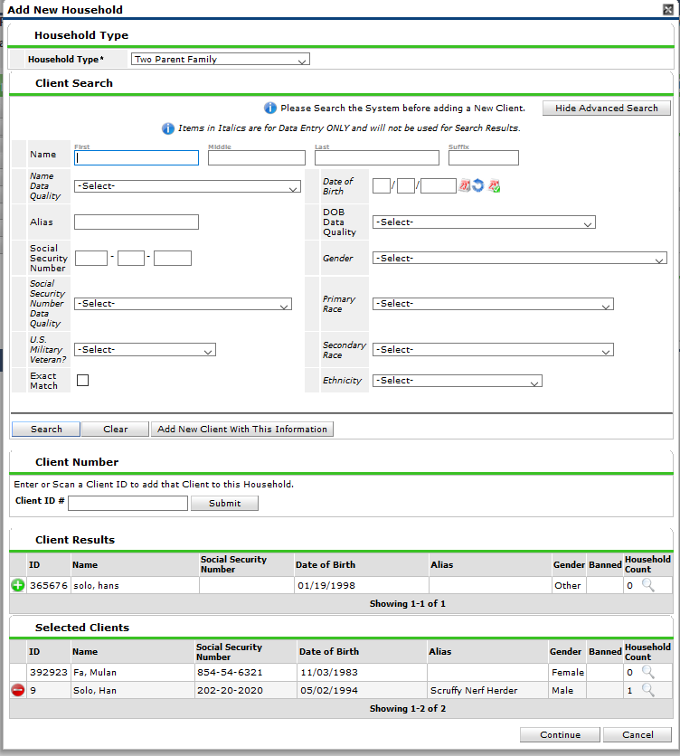
If the client doesn’t appear in the search, add the new client in the Add New Household Tab.
You MUST search for the client record before you are able to create a new client record.
You MUST enter all the information indicated BEFORE you click “Add New Client With This Information”

Slide 27
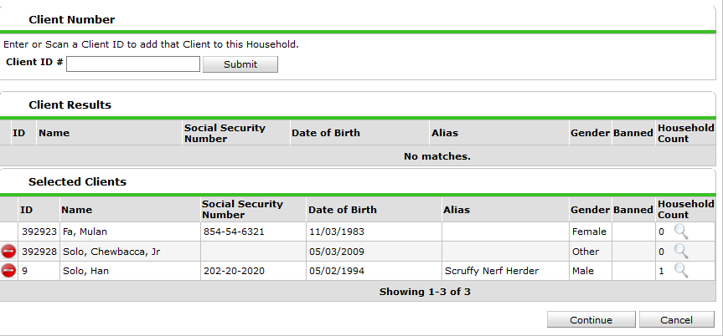
Once the household is fully built, Click Continue.

Slide 28
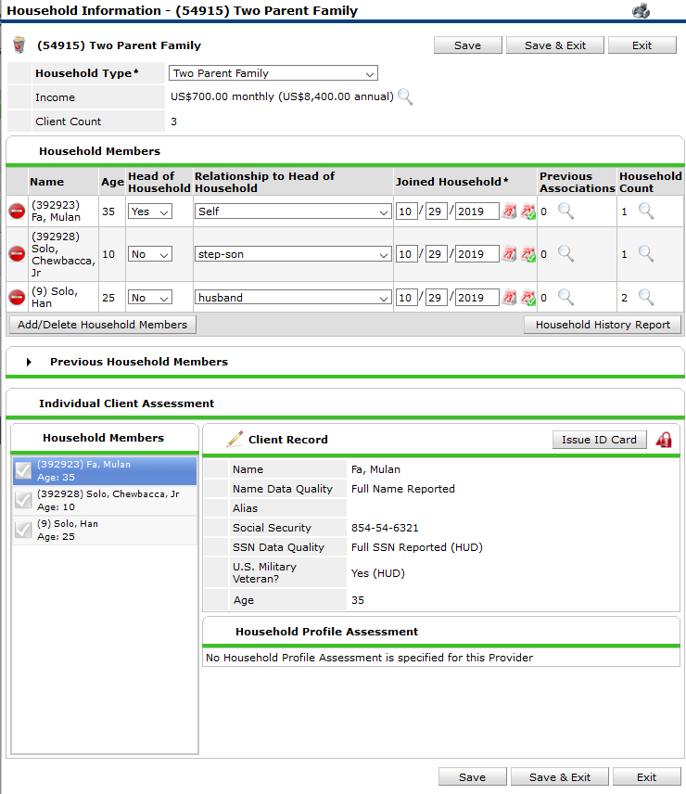
In the Household Members section, assign 1 person as Head of Household = Yes. This will automatically make the client’s relationship to Head of Household = Self.
Then select the Relationship to Head of Household for the other household members.
When complete, click “Save & Exit”

Slide 29
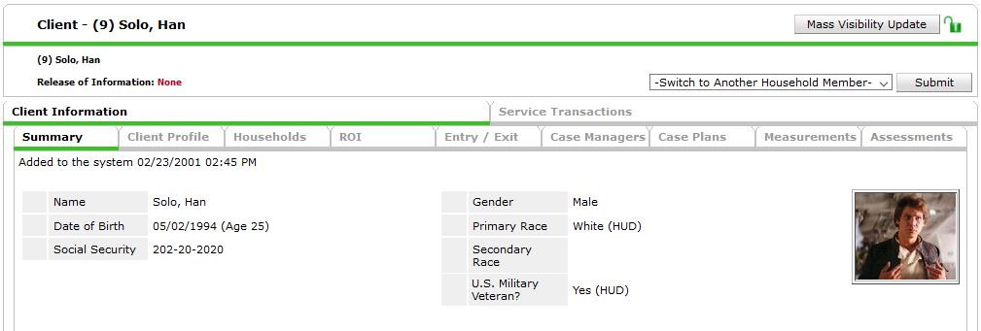
Creating an entry
To document the client’s participation in the program, you need to create an Entry.
Navigate to the Entry/Exit Tab.

Slide 30
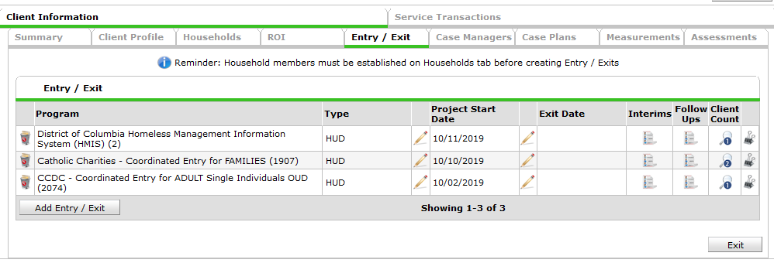
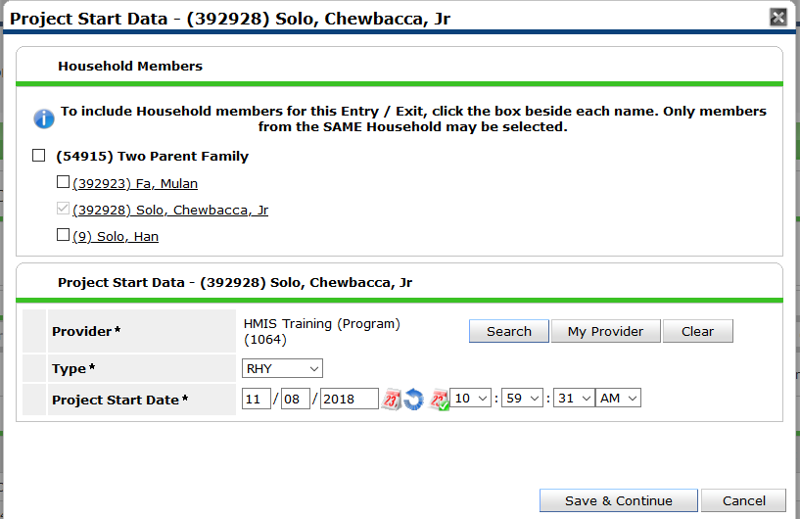
Click “Add Entry/Exit”
Choose the correct Provider
Choose the correct Type
Set the Project Start Date
Click Save & Continue
Notes:
If your provider is RHY then use RHY, for all others use HUD.

Slide 31
The Entry Assessment
The Entry Assessment captures the universal data elements requested by the Federal Partners and DC CoC as well as any program specific data elements required for your agency’s funding source.
Street Outreach, Emergency Shelters, and Safe Havens have a different set of assessments than all other project types. This is due to the way HUD captures Previous Living Situation information.
Most programs (Non SO, ES, or SH) have the Entry for Youth TH, HP, & PH (2020) TCP assessment. This is the required assessment for all HUD CoC, DHS, and RHY funded programs.

Slide 32
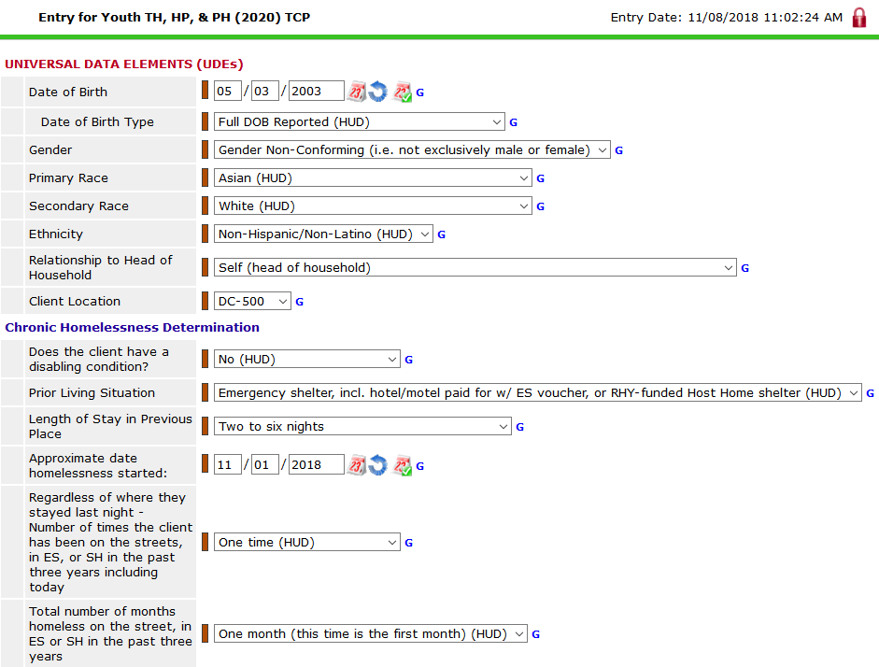
Notes:
IF the Client Demographics are missing, go back up to the Client Demographics box on the Client Profile tab and add the information there. This will ensure the information on is visible to ALL users, not just you. If that section is complete but your assessment is not, add the information to the assessment.
It is important that you read each question and answer it as of the program start date/entry date.

Slide 33
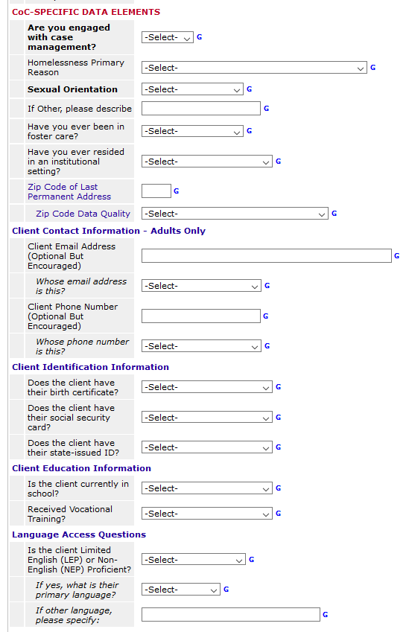
These are DC’s Universal Data Elements. They are required regardless of your program’s funding.

Slide 34
Domestic Violence questions
Domestic Violence Questions should be completed for Heads of Households and Adults.
Verification is not necessary unless required by your funder.

Slide 35
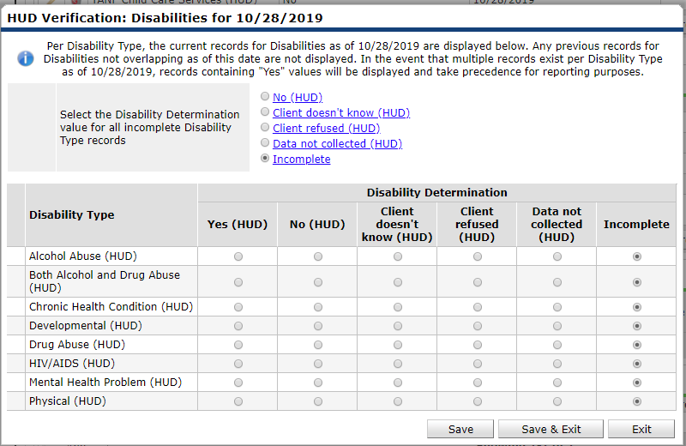
Begin by setting all incomplete values to “No”
For each Disability, add the disability type, determination, duration, and start date.
Once all Disabilities have been recorded via the HUD Verification, click “Save & Exit”

Slide 36
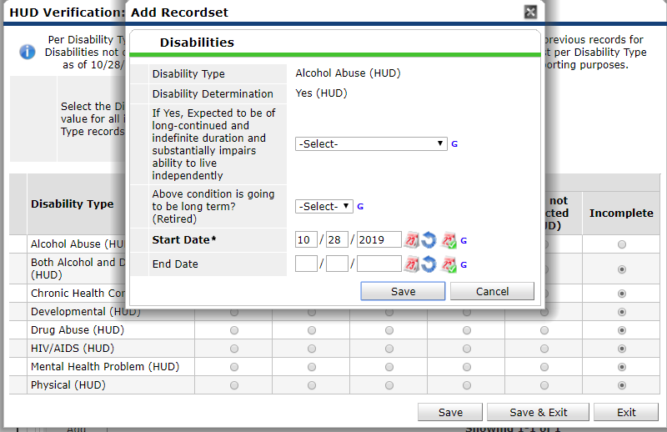
For each Disability, add the disability type, determination, duration, and start date.
Once all Disabilities have been recorded via the HUD Verification, click “Save & Exit”

Slide 37
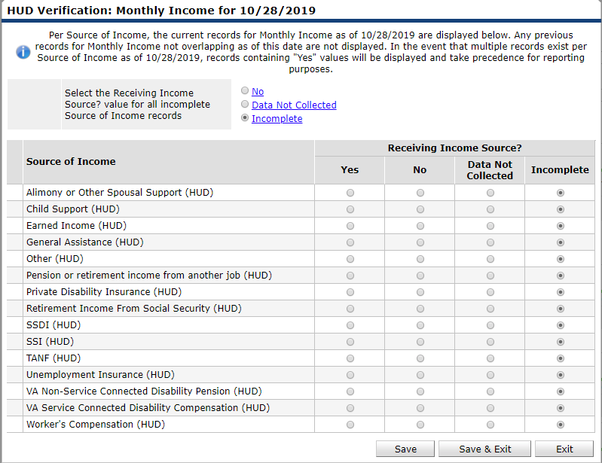
Begin by setting all incomplete values to “No”
For each source of income, add the income source, receiving income source = Yes, monthly amount and start date.
Once all income sources have been recorded via the HUD Verification, click “Save & Exit”

Slide 38
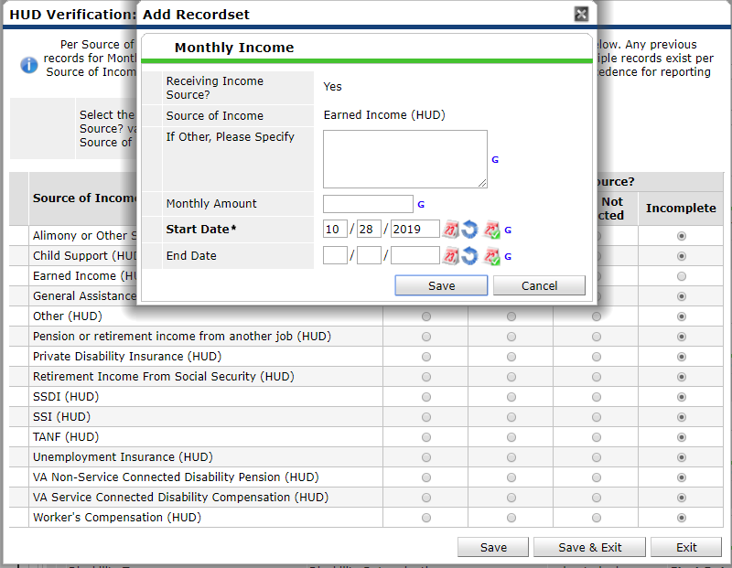
Begin by setting all incomplete values to “No”
For each source of income, add the income source, receiving income source = Yes, monthly amount and start date.
Once all income sources have been recorded via the HUD Verification, click “Save & Exit”

Slide 39
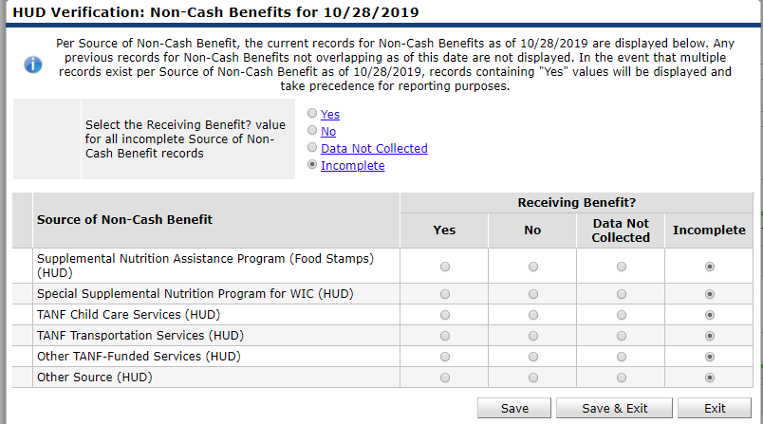
Begin by setting all incomplete values to “No”
For each source of Non-Cash Benefits, add the Non-Cash Benefit source, receiving benefit = “Yes”, and start date
Once all Non-Cash sources have been recorded via the HUD Verification, click “Save & Exit”

Slide 40
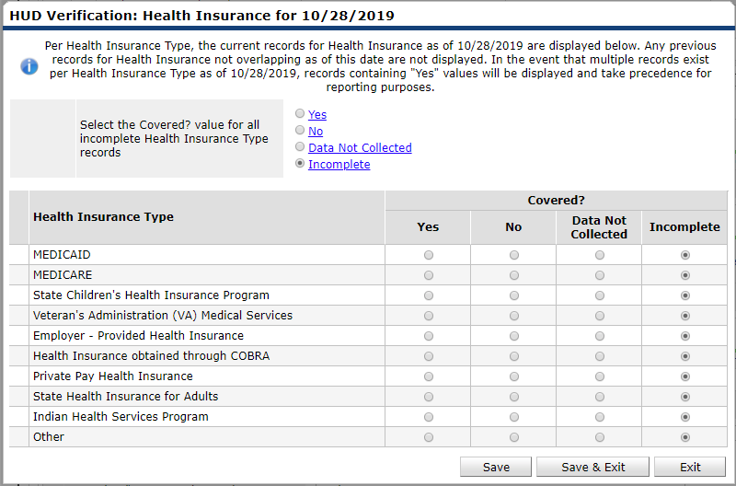
Begin by setting all incomplete values to “No”
For each type of Health Insurance, add the Health Insurance type, covered? = “Yes”
Once all Health Insurance sources have been recorded via the HUD Verification, click “Save & Exit”

Slide 41
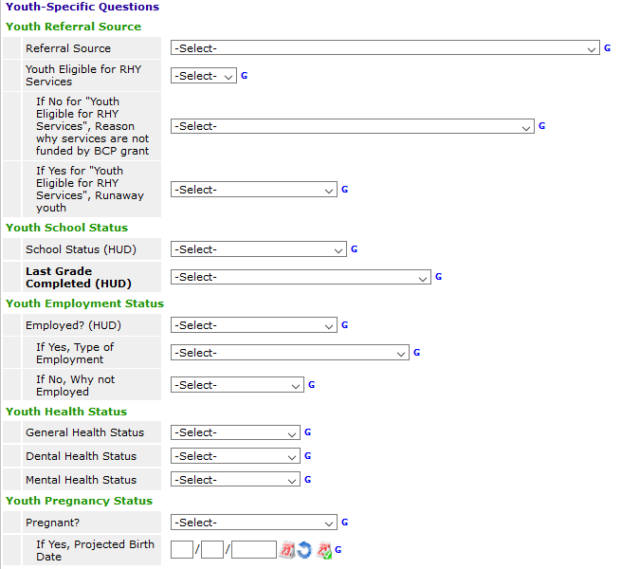
These are questions that are specific for youth providers.
These are required for all heads of household and adults.

Slide 42
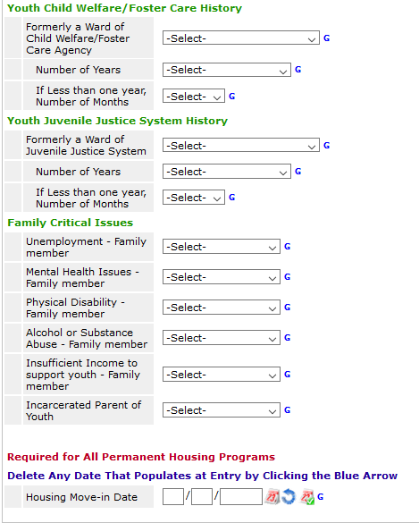
This is a continuation of the youth specific questions.
Housing Move-In-Date will be detailed in the following slide.
Notes:
Housing Move-In-Date will be detailed in the following slide.

Slide 43
Rapid Re-housing and Permanent Housing
For clients with a Project Start Date in a permanent housing project of any kind (including Rapid Re-housing), record the date a client or household moves into a permanent housing unit.
When Entering a client into your program, you will want to make sure any Date that populates in the Housing Move-in Date is cleared so that the new, correct date may be entered for your program.
This Housing Move-in Date MAY be the same date as the Entry Date, but more likely it will occur AFTER the entry date.
IF it is on the same date as the Entry Date you MAY enter it on the Entry Assessment.
If it is AFTER the Entry Date, you MUST enter it in an Update.
It is also possible that you may begin serving the client with the housing search, but end up unable to house the client. In this case the Housing Move-in Date will remain Blank and the client will be exited from your program.
Housing Move In Date
Notes:
Additional Info about HMI Date: For RRH projects only, a Housing Move-in Date must be entered regardless of whether or not the RRH project is providing the rental assistance for the unit. For example, if an RRH project provides supportive services, but is not providing the rental assistance for the unit, a Housing Move-in Date must still be entered to differentiate RRH clients in housing from those still experiencing homelessness.
For any other project types that are typed as 'Permanent Housing' in the HMIS, clients who are receiving pre-housing placement services but are ultimately housed by another project or subsidy source should be exited from the PH project to the appropriate permanent Destination. If the client exits the permanent housing project for a different housing opportunity without physically moving into a housing unit associated with the project, do not enter a housing move-in date, simply exit the client and record the exit destination.
In the event that the client vacates a housing situation and the project stops paying rental assistance, staff should exit the client from the project with an accurate Project Exit Date and Destination and create a new Project Start Date in a second enrollment for the client on the same or following day. The project would continue working with the client until a new unit is found, at which point a new housing move-in date would be recorded on the second project record. This will ensure that the client’s history of housing is preserved.
If the client moves directly from one unit into another unit, with no days of homelessness in between, it would not be necessary to exit and re-enter them, because their housing move-in date would still accurately reflect the day they entered permanent housing according to that enrollment record.
In the event a client is transferred into a PSH or RRH project having already moved into a permanent housing unit, the client’s Project Start Date and Housing Move-in Date will be the same date. It is not necessary or appropriate to have the Housing Move-in Date reflect the original move-in, since the purpose of the data element is to distinguish between housed and homeless statuses during a single enrollment.

Slide 44
Updates and Annual Assessments
Updates are required for some data elements, including Housing Move-in Date.
Annual Assessments are required to be entered within +/- 30 days of the Head of Household’s Entry Anniversary.
Updates and Annual Assessments have fewer questions to complete and/or update compared to the Entry Assessment.
If you do not complete these, the system does not recognize the change in income and non-cash benefits that occur.

Slide 45
Creating an Update/Annual Assessment

Slide 46
Creating an Update/Annual Assessment

Slide 47
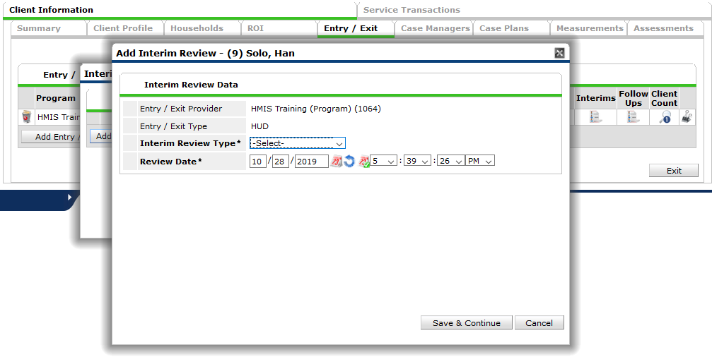
Creating an Update/Annual Assessment
Notes:
Updates should use the Interim Review Type “Update”
Annual Assessments should use the Interim Review Type “Annual Assessment”

Slide 48
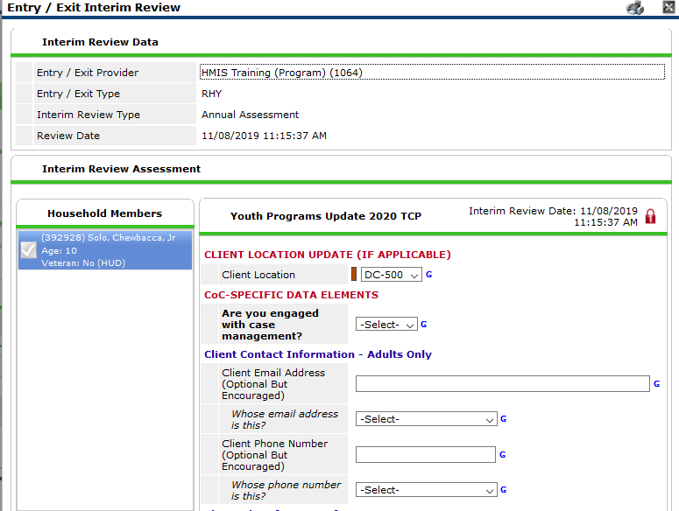
Interim Review Assessment
The questions in the Interim review(Update or Annual Assessment) will depend upon the funding source of your program.
Interim reviews generally contain data elements that may change over time.
Review all information in the Interim Review to ensure it is still up-to-date. Make updates as needed.

Slide 49
Updating Sub-assessments
If information in a sub-assessment has changed, we need to end the old information, and create new, accurate information.
We do not want to Delete any information that used to be correct.
We will add an End Date to the information that is no longer true, and then Add a new line in the sub-assessment with the new information.

Slide 50
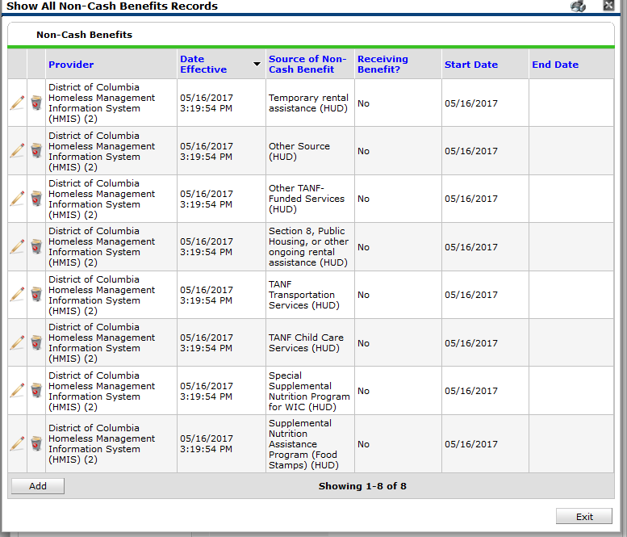
Here we have the details of the Non-Cash Benefits sub-assessment.
In my update, I find out that the client now has Food Stamps. I will want to update this information in HMIS.

Slide 51
Here we have the details of the Non-Cash Benefits sub-assessment.
In my update, I find out that the client now has Food Stamps. I will want to update this information in HMIS.
This information is no longer true. I will add an End Date to this record for yesterday.

Slide 52
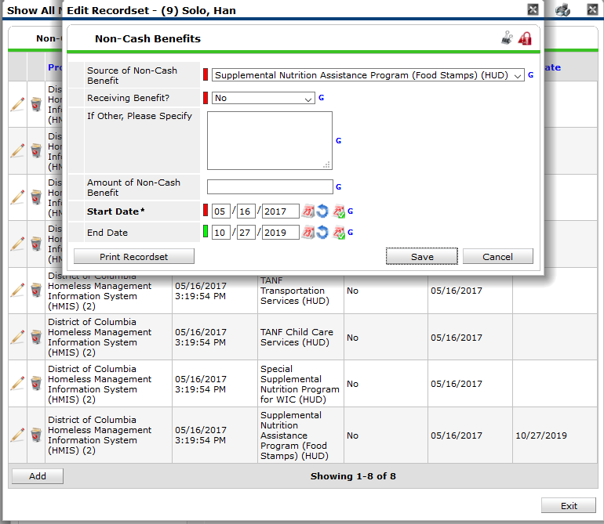
Here we have the details of the Non-Cash Benefits sub-assessment.
In my update, I find out that the client now has Food Stamps. I will want to update this information in HMIS.
This information is no longer true. I will add an End Date to this record for yesterday.
Once the End Date has been added, I will need to Add a new record for Food Stamps.

Slide 53
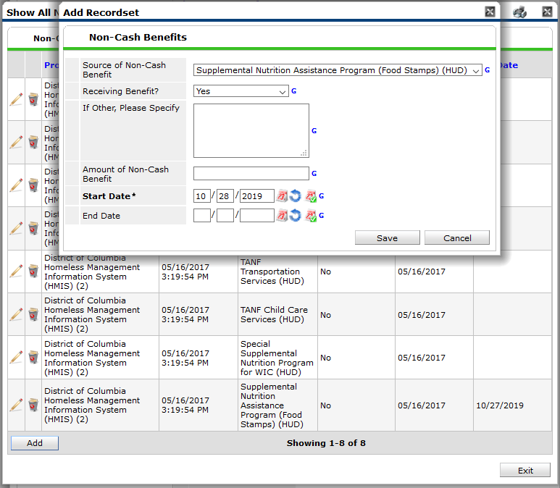
Here we have the details of the Non-Cash Benefits sub-assessment.
In my update, I find out that the client now has Food Stamps. I will want to update this information in HMIS.
This information is no longer true. I will add an End Date to this record for yesterday.
Once the End Date has been added, I will need to Add a new record for Food Stamps.
Since the client is receiving food stamps now, I answer “Receiving Benefit” = “Yes.
The Start Date = today’s date.
Notes:
This way there is not an overlap in the Sub-assessment where a client appears to be both receiving and not receiving Food Stamps.

Slide 54
Exiting a client
Sometimes, clients leave your program before the entire household leaves. You will need to create an exit for this client that is separate from the other members of the household.
Navigate to the exiting client’s ClientPoint record.

Slide 55
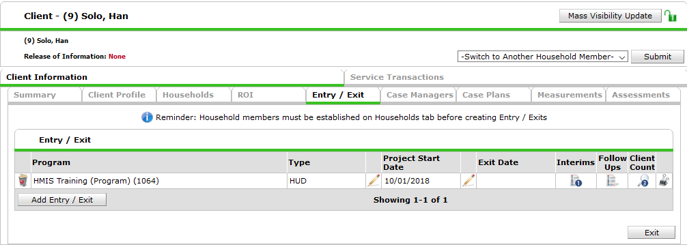
Exiting a single client
Find the correct entry/exit – the client count is a way to make sure it is the entry you are looking for as well as the Provider name and the Project Start Date.
Click on the Edit Pencil for the Exit Date.

Slide 56
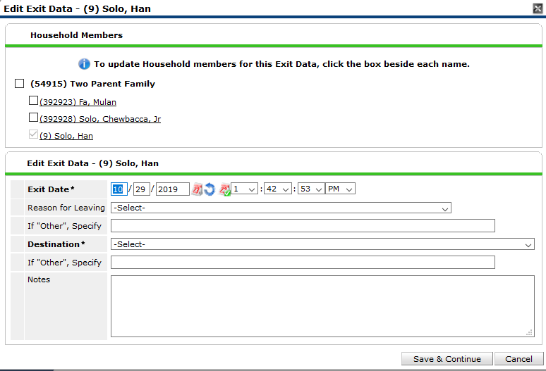
Exiting a single client
Make sure the correct client is selected.
Set the exit date to the date the client left your program and the time to the standard 12:01:00 A.M.
Set the exit Destination. The destinations with “(VW)” next to them are specific to Virginia Williams.

Slide 57
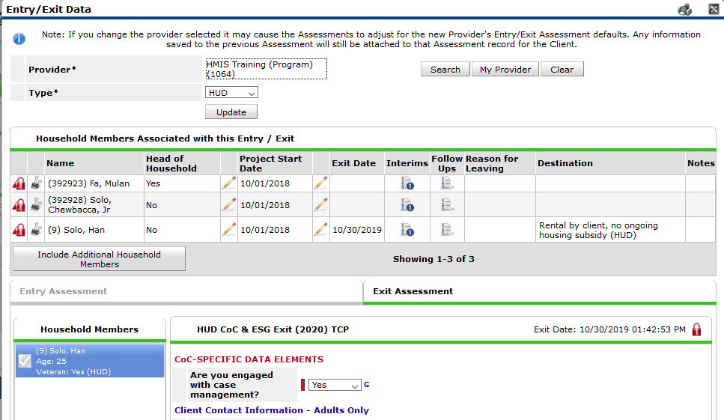
On the Entry/Exit Data pop-up you will now see that one client is exited while the other two household members are still in the program.
The Exit Assessment is similar to the Update and Annual Assessment in that you can update the same fields if anything changes the day the client leaves your program
Depending on your program’s funding source, you may have additional questions that only appear at Exit.
Be careful to read the assessment carefully to ensure you are answering all questions.

Slide 58
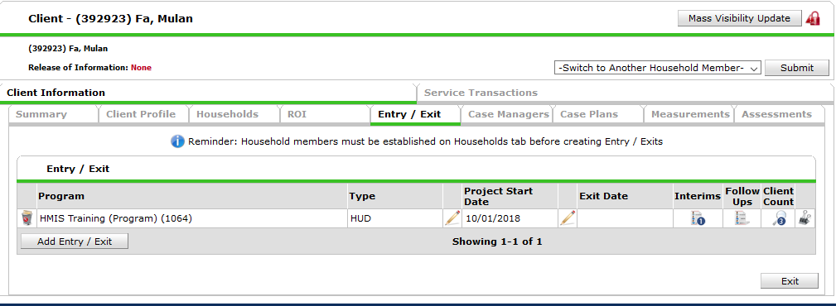
Exiting a Household
When the household exits your program, you will need to create an exit for all household members.
Navigate to the Head of Household’s client record in ClientPoint and then go to the Entry/Exit Tab.

Slide 59
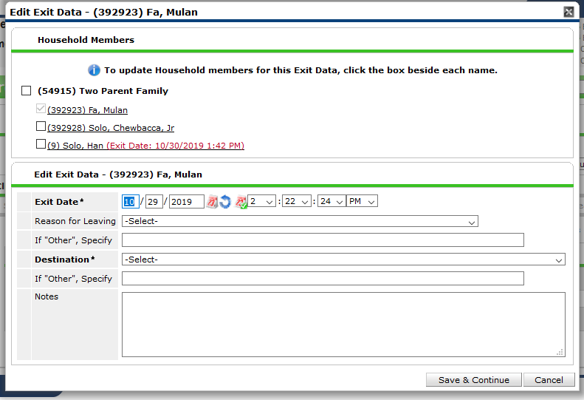
Exiting a Household
Make sure the correct clients are selected. In this household, one of the clients was exited earlier. Select the other clients in the household.
Set the exit date to the date the client left your program and the time to the standard 12:01:00 A.M.
Set the exit Destination. The destinations with “(VW)” next to them are specific to Virginia Williams.

Slide 60
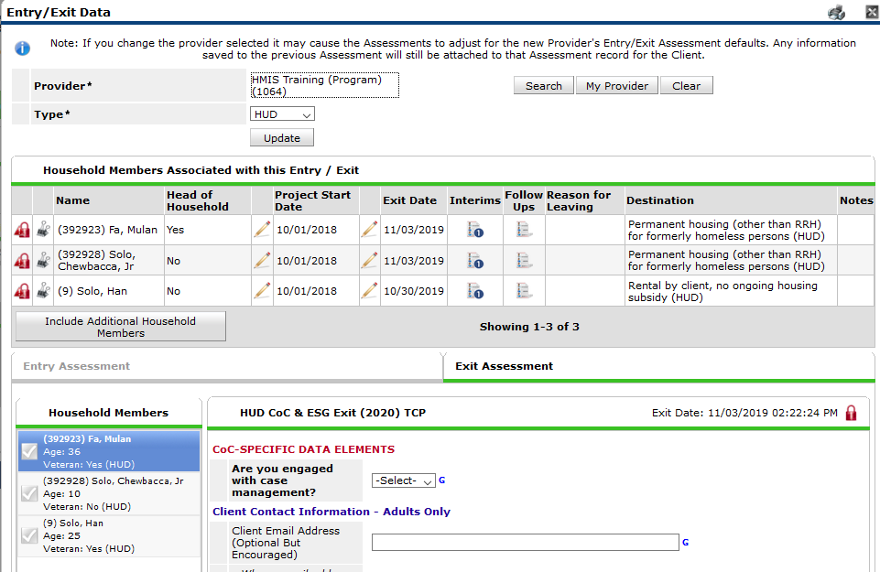
On the Entry/Exit Data pop-up you will now see that all clients are exited with two different exit dates because the different household members exited on different dates.
The Exit Assessment is similar to the Update and Annual Assessment in that you can update the same fields if anything changes the day the client leaves your program
Depending on your program’s funding source, you may have additional questions that only appear at Exit.
Be careful to read the assessment carefully to ensure you are answering all questions.

Slide 61
2020 Data Standards Changes
These changes went into effect on October 1st, 2019
We have updated the assessments in HMIS to contain the current required questions.
We are in the process of updating reports in ART for data quality reports.

Slide 62
Universal Data Element Changes
Prior Living Situation
Formerly named Living Situation
Picklist now aligns with Destination and Current Living Situation
Wording change to “Emergency shelter, including hotel or motel paid for with emergency shelter voucher, or RHY-funded Host Home shelter
Addition of “Host Home (non-crisis)”
Wording change to “Rental by client, with RRH or equivalent subsidy”
Wording change to “Rental by client, with HCV voucher (tenant or project based)”
Wording change to “Rental by client in a public housing unit”
Data Entry Implications:
New and changed options moving forward
Sexual Orientation
Added picklist value
Questioning/unsure
Other
Text box for “Other”
Destination
Picklist now aligns with Prior Living Situation and Current Living Situation
Wording change to “Emergency shelter, including hotel or motel paid for with emergency shelter voucher, or RHY-funded Host Home shelter
Addition of “Host Home (non-crisis)”
Wording change to “Rental by client, with RRH or equivalent subsidy”
Wording change to “Rental by client, with HCV voucher (tenant or project based)”
Wording change to “Rental by client in a public housing unit”
Added Dependent A text box for “Other”
Data Entry Implications:
New and changed options moving forward

Slide 63
Program Specific Element Changes
Developmental Disability and HIV/AIDS
Within the Disabilities Sub-assessment
Removed the dependent element “Substantially impedes the individual’s ability to live independently”
Data Entry Implications:
One fewer question to answer for these two elements
Domestic Violence
Data Entry now required for SSVF
Data Entry now required for PATH
PATH Status
For PATH Providers only
Added picklist value to “No” for Client Enrolled in PATH – “Unable to locate client”
Employment Status
Data Entry now required for VA GPD Low Demand
Data Entry now required for VA GPD Case Management/housing relocation

Slide 64
Program Specific Element Changes
Pregnancy Status (RHY Providers)
Data Element now required for ALL female Heads of Household regardless of age
Previously only required for ADULT female Heads of Household
VAMC Station Number
Data Entry now required for the following
VASH - ALL Components
VA-CRS – Contract Residential Service
VA – Community Contract SH Program
VA – Grant Per Diem (GPD) – ALL Components
HUD VASH Voucher Tracking
Collection point changed from Project Start, Update, and Project Exit to Occurrence Point/Update.
Current Living Situation
Replaces “Contact”
Required to be completed for each direct client contact for
Street Outreach
Coordinated Entry (HUD CoC funded only)
Emergency Shelter – Low Barrier and Severe Weather only
Data is recorded for Heads of Household on each occurrence/update

Slide 65
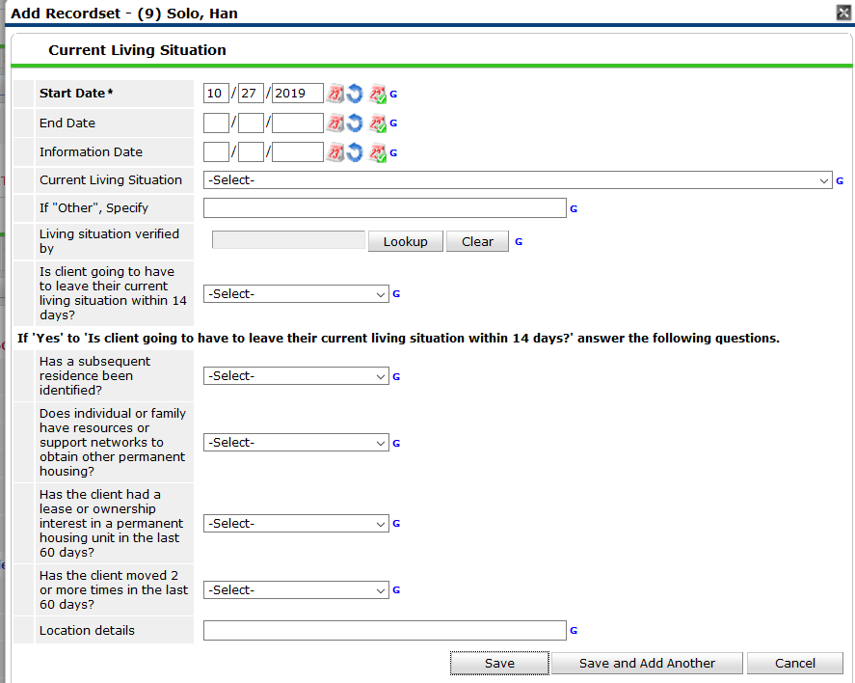
The Current Living Situation (CLS) sub-assessment replaces the “Contact” sub-assessment from previous years.
A CLS should be created each time a client has been directly contacted in a meaningful way.
This should be recorded for Heads of Household for each occurrence.

Slide 66
Common Data Entry Errors
Creating an Entry with the wrong provider
Exiting a client by mistake
Creating an Update instead of an Annual Assessment

Slide 67
Creating an Entry with the Wrong Provider
Sometimes we create an Entry in our Agency provider or another program provider by mistake.
This can be fixed by updating the Entry Provider. You first need to click the Entry Edit Pencil.

Slide 68
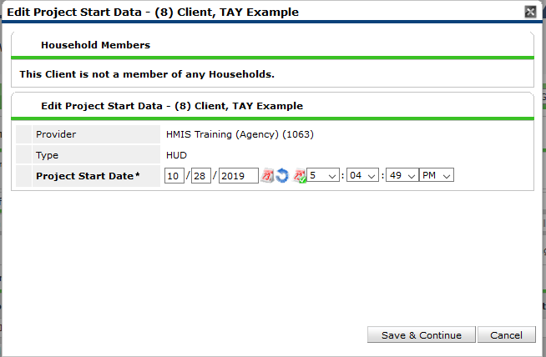
Creating an Entry with the Wrong Provider
Sometimes we create an Entry in our Agency provider or another program provider by mistake.
This can be fixed by updating the Entry Provider. You first need to click the Entry Edit Pencil.
Then you click “Save & Continue”

Slide 69
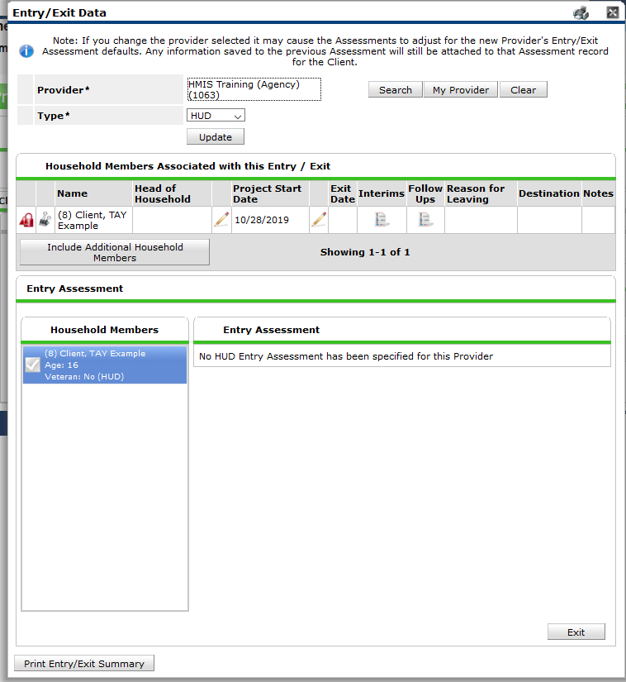
A clue that we have used the wrong provider is that there is no Assessment connected with this providers HUD Entry Type.
To update the Provider, Click “Search” next to the Provider.

Slide 70
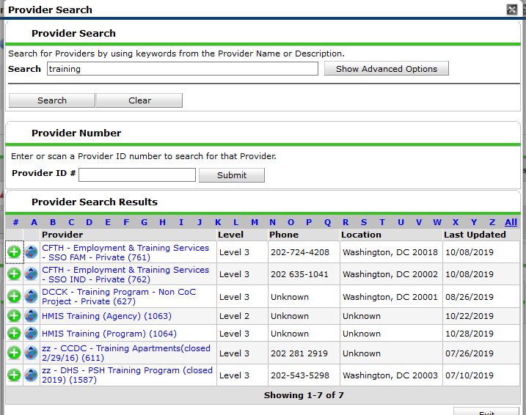
A clue that we have used the wrong provider is that there is no Assessment connected with this providers HUD Entry Type.
To update the Provider, Click “Search” next to the Provider.
Search for the correct provider and click the green plus sign.

Slide 71
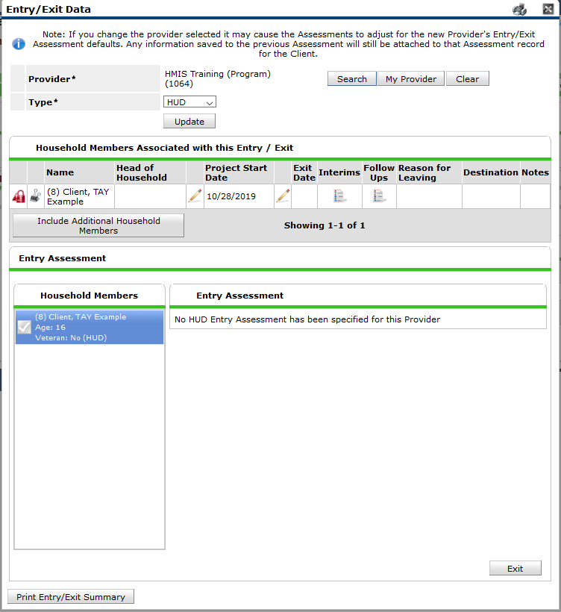
A clue that we have used the wrong provider is that there is no Assessment connected with this providers HUD Entry Type.
To update the Provider, Click “Search” next to the Provider.
Search for the correct provider and click the green plus sign.
In order for this change to be saved, click “Update”

Slide 72
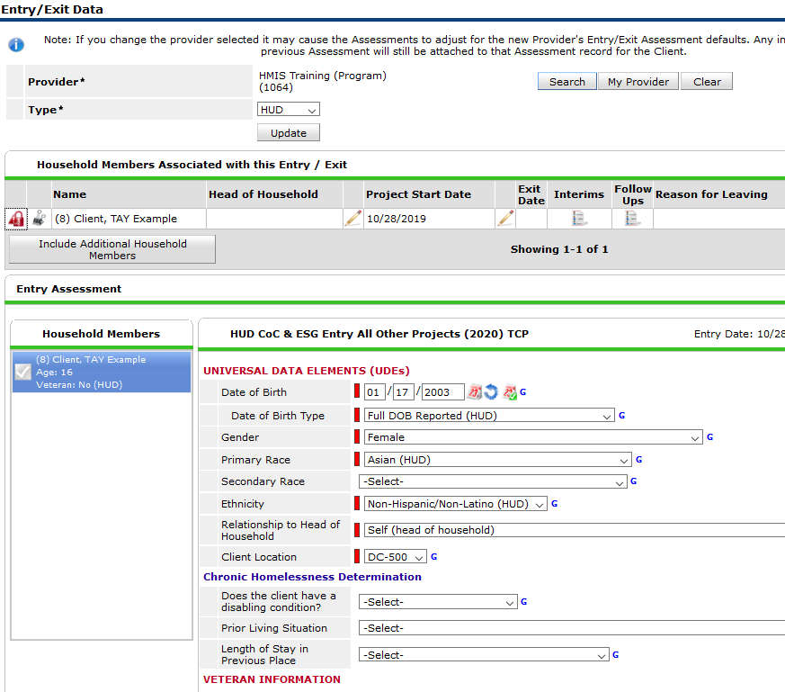
A clue that we have used the wrong provider is that there is no Assessment connected with this providers HUD Entry Type.
To update the Provider, Click “Search” next to the Provider.
Search for the correct provider and click the green plus sign.
In order for this change to be saved, click “Update”
The correct assessment will now appear.

Slide 73
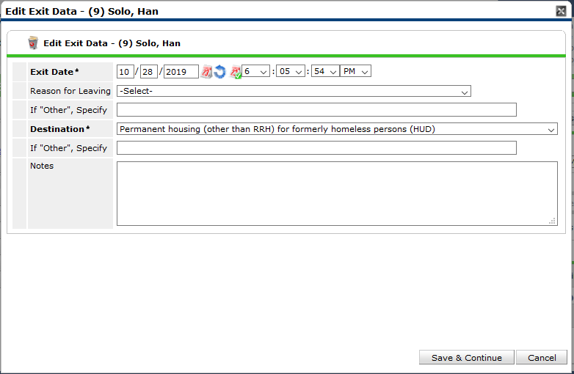
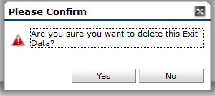
Exiting a Client by Mistake
Sometimes we exit a client when we did not mean to.
This can be fixed by deleting the exit. First we must click the Exit Edit Pencil.
Then we click the Trash can in the Edit Exit Data pop-up.
Click “Yes” to confirm and delete the exit.

Slide 74
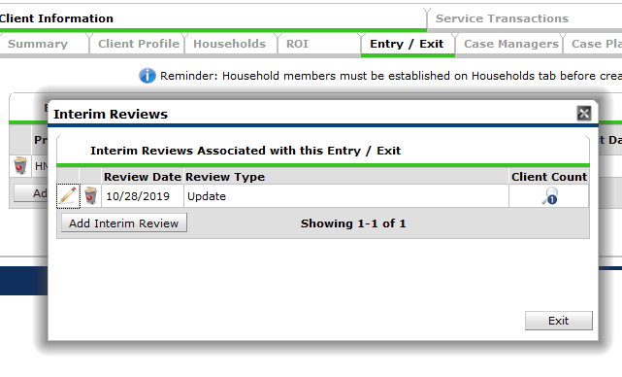
Creating an Update instead of an Annual Assessment
Sometimes we choose the wrong type of Interim Review.
Here I meant to enter an Annual Review but made an Update instead.
This can be fixed by updating the Interim Review Type.
Click the Edit Pencil for the Update.

Slide 75
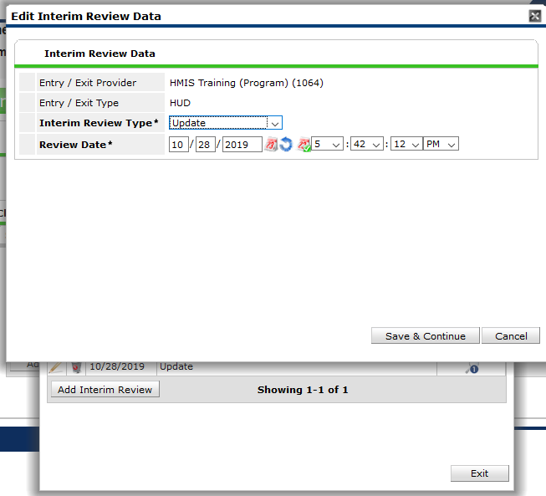
Change the Interim Review Type to Annual Assessment
Click Save & Continue.
If you have already made all your updates to the Assessment, click Save & Exit.

Slide 76
Additional Resources
Helpdesk: hmis@community-partnership.org
Email the helpdesk with questions and we will provide answers and resources.
We respond within 2 business days.
Trainings:
We hold HMIS trainings every month.
They are open to all, new user, seasoned veteran, or anywhere in between
Training eventbrites are found at http://community-partnership.org/providers/training
Have questions about the trainings? Email the helpdesk!

Slide 77
Thanks for participating!
Questions?
HMIS Help-Desk Email: hmis@community-partnership.org

