Slide 1
The Weekly Occupancy Report
An updated report and process

Slide 2
Agenda
What is the Weekly Occupancy Report
Why do we complete it?
How do we use it?
Why are we adding new program types?
What is expected of Agencies
How to read the new report format
Next Steps
Resources

Slide 3
What is the Weekly Occupancy Report?
As the name suggests, this is a report that is created weekly that looks at the occupancy, and thus the vacancies of programs in the DC CoC on each Thursday.
This report is used by our Coordinated Entry committees and teams to best navigate the process of placements of clients.
It is also used by grant staff at TCP and DHS to monitor program's occupancy levels.
This report gives individual program information as well as aggregate information about our homeless response system.
And why does it matter?

Slide 4
We’re Adding new programs!
As the Weekly Occupancy Report has progressed in years, we have continued to broaden the groups of programs that are included.
This is to give our community the best picture possible for what our system use and how much availability we have in our programs.
This update will be adding FRSP, PSHP, and TAH programs.
These are large programs and their addition will give a much clearer picture of our whole system.
But why? And which?

Slide 5
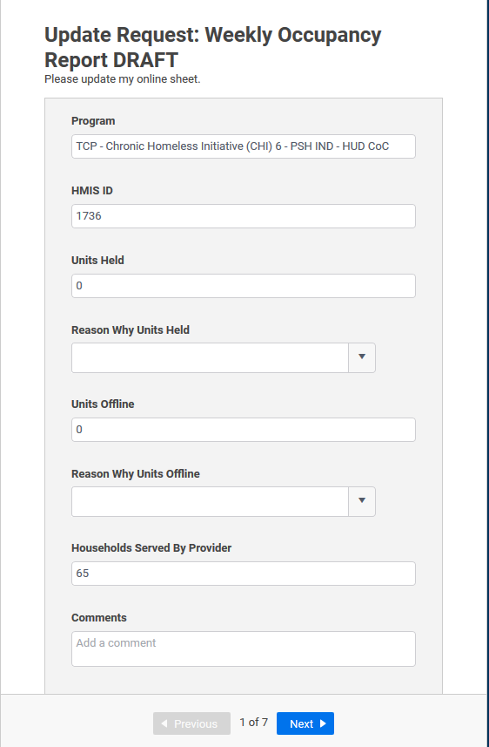
Agency Expectations
Each week on Thursday you will complete this form for each of your programs.
The following Monday you will receive information on whether your HMIS information matches what you have submitted for that Thursday. You will make corrections to your HMIS information.
Rinse. Repeat.

Slide 6
How to Complete the Form
You will receive an automated email every Thursday asking you to update your responses. It will show you what is currently in the report and a button to open the update form.
Each provider/program will have its own form. If you have multiple programs you will see a next button.

Slide 7
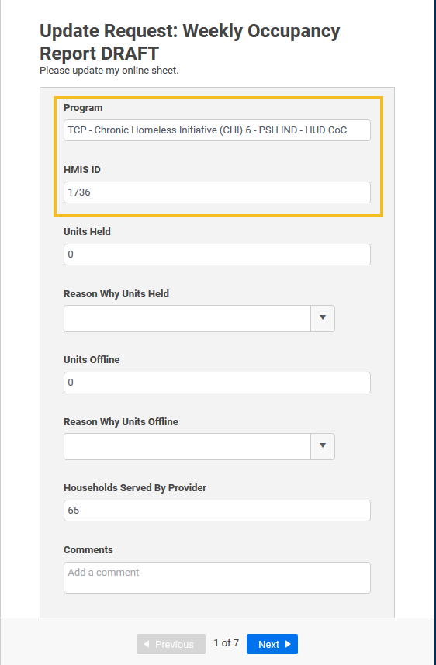
Program and HMIS ID
These are not to be changed. They are there for you to be able to know which program we are talking about.

Slide 8
Units Held
These are the number of units/slots held for clients/households that are about to move into, but have not yet, a shelter or transitional housing program, as well as CAHP Matches.
If there are no units held, please type 0.
If your program does not hold units/case management slots please type 0.

Slide 9
~NEW~ Reason Why Units Held
In order to bring more transparency and clarity to why units are being held, we have added this question.
It is currently sparsely populated, so if the answer is other, use the comments section to better describe the reason.
As we find consistent reasons for units being held beyond CAHP matches we will add them to the drop-down menu.
If you have no units held, leave this blank.

Slide 10
Units Offline
These are the units that are unavailable for placement due to various reasons.
A list of potential reasons is available in the next section.
If there are no units offline, please type 0.

Slide 11
~NEW~ Reason Why Units Offline
In order to bring more transparency and clarity to why units are offline, we have added this question.
It is currently sparsely populated, so if the answer is other, use the comments section to better describe the reason.
As we find consistent reasons for units being offline beyond those options already available we will add them to the drop-down menu.
If you have no offline units, leave this blank.

Slide 12
Households Served By Provider
This is the number of households in your program on Thursday.
This should only be those actually in your program, not including those waiting to come into your program or those who have exited and are waiting for an appeal process.

Slide 13
~NEW~ Comments
If you have additional information you would like us to know, or if you chose “Other” for either of the “Reason…” categories, please use the Comments section to describe.

Slide 14
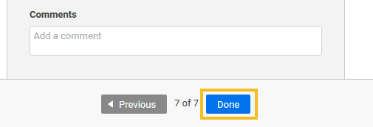
Next Program or Done
Once you have answered all the questions, you will either select “Next” to go to your next program, or you will select “Done” to submit your answers for the week.
Once you have completed all your programs, you will see the “Done” option.

Slide 15
Communications to You
You will receive 3 emails a week:
Thursday afternoon - a request to submit your numbers by EOD Thursday
Friday morning - the submitted report for your information
Monday morning - an email of your reported numbers versus HMIS numbers with a reminder to submit the next round by Thursday EOD

Slide 16
How to Read the Report
This report merges the old report’s 3 tabs into a single, collapsible sheet of information.
You can view all details or only the pieces that interest you.
This will go over the various ways to look at the report and what each column is and how it is calculated if applicable.

Slide 17
Fully Condensed
This way of looking at the report gives the top line numbers of our system use only.
Green = Emergency Shelter
Orange = Transitional Housing
Purple = Rapid Rehousing
Brown = Permanent Supportive Housing

Slide 18
Contracted Units
This the total number of units we have contracted for that program type.
It is the sum of the contracted units amounts from each program in the category.
This number can change as programs close and open or if they have changes in funding that increase or decrease their contracted units.

Slide 19
Units Held
This is the total number of units in the program type that are being held.
Reasons for a unit being held include a client or household being matched to the program via CAHP.
The specifics of why units are held are located at the program level of this report.

Slide 20
Units Offline
This is the total number of units in the program type that are offline.
Reasons for a unit being offline vary from short-term maintenance, long term building improvements, or even if there is an extra-large family in the program that must use multiple units.
The specifics of why units are offline are located at the program level of this report.

Slide 21
Households Served by Provider
This is the total number of households served in the program type.
This information is based off programs’ self-report unless they do not supply that information to us, in which case we pull the information out of HMIS.
As HMIS data quality improves, we may move to only pulling out of HMIS this specific number.

Slide 22
Vacancies
Vacancies is a calculated field.
It takes the contracted units and removes the units held, the units offline, and the households served by the provider.
This gives the number of units that are available for placements as they are vacant.

Slide 23
Occupancy Rate
Occupancy Rate is a calculated field.
It takes the number of households served and divides that by contracted units minus units held and minus units offline.
The higher the percentage, the more occupied the program type beds are.

Slide 24
Sub-Categories
If you click the plus sign on any of the program type lines, it will open the program type to show sub-categories of the program type. These sub categories all add up into the main program type. The sub-categories are color coded with lighter hues get added together to create the darker hues, and then the darker hues of each color are added together to create the color of the main program type line.
Notes:
In this case, the light blue adds together to create the medium blue for Adult beds. The two medium blue lines get added together to create the dark blue line. This gets added to the dark yellow and the grey lines to create the green line that is all Emergency Shelters.
This level of the report gives you all the information previously found on the first tab of the old version of the report.

Slide 25
Provider/Program Detail Information
Opening the report further will show information previously found on the two detail tabs.
This includes a line for each program/HMIS provider participating in this report.
At this level information about why units are held or offline appears. HMIS IDs and funding sources also appear.
The following slides show the Emergency Shelter details. This pattern of singles and families is repeated in each program type (Emergency Shelter, Transitional Housing, Rapid Re-housing, Permanent Supportive Housing).

Slide 26
Singles

Slide 27
Families

Slide 28
Short Term Family Housing

Slide 29
Next Steps
2/27/2020 you will submit your numbers via the Smartsheet form.
I will be standing by to troubleshoot and answer questions as needed.
wor@community-partnership.org
2/28/2020 The first updated report will be sent to view in Smartsheet.

Slide 30
Resources
Weekly Occupancy User Guide
Intended Audience: Agency Staff completing the Weekly Occupancy Report.
Contains:
How to complete the form
Common Data Entry Errors affecting the report (and how to fix them)
How to add or remove programs
How to change who gets the emails
New Agency Information
Location:
How to Read the Weekly Occupancy Report
Intended Audience: anyone reading the Weekly Occupancy Report
Contains:
Background on the report
How to read the report
Limitations of the report
Location:

Slide 31
Thanks for participating!
Questions?
Weekly Occupancy Report Email: wor@community-partnership.org

