Slide 1
HMIS Training
DC 101: Singles Entry Exit Workflow

Slide 2
Agenda
HMIS Basics and Policies
Intro to ServicePoint
Enter Data As
Singles programs Data Entry Steps
Common Data Entry Errors
Additional Resources
Agency Admins
TCP Website
Helpdesk
Trainings
Next Steps

Slide 3
HMIS Basics Recap
DC’s HMIS
Visibility Basics
Data Security
Notes:
For more information view the DC 100 training

Slide 4
What is HMIS?
Homeless Management Information System
Tool required by funders of homeless services providers
Way to keep track of services, case plans, assessments, and housing for clients
Way for community to learn of system flow and cracks in our homeless response system
This is all thanks to YOU for completing accurate and timely data entry for the clients you serve!
Notes:
HMIS has been around for a long time!
DC began the use of a software for HMIS in May of 2001.
While it began as a mandate from the Department of Housing and Urban Development, it has grown far beyond that and is now a way that our whole homeless response system is able to coordinate and collaborate to help solve homelessness here in the District.
The system relies upon you as end users to help by completing accurate and timely data entry for the clients you serve.

Slide 5
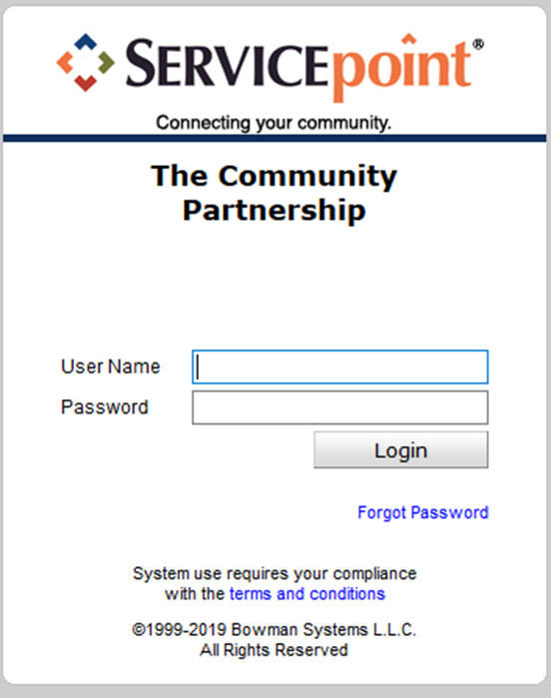
ServicePoint – DC’s HMIS Software

Slide 6
Who Can See What?
The database contains hundreds of thousand client files, each with dozens of project stays, services, and case notes.
Having a visibility structure is important to ensure client information is protected, while also ensuring agencies and programs are able to work together to help clients.
Client choice to share their program level information is at the heart of our visibility structure.
Visibility and Data Security

Slide 7
Visibility Basics – Current Structure
DC’s Lead Agency
Agency A
Agency B
Program 1A
Program 2A
Program 1B
Notes:
Now agencies are able to see all of their own information. Only some information is shared across agencies.

Slide 8
HUD UDEs – What’s Shared & What Isn’t
Universal Identifiers (one answer per client record)
Universal Project Stay elements (One or more values per project stay)
Name
Name Data Quality
Social Security Number
Social Security Number Data Quality
Date of Birth
Date of Birth Data Quality
Race
Ethnicity
Gender
Veteran Status
Disabling Condition (Yes/No)
Project Start Date
Project Exit Date
Destination
Relationship to Head of Household
Client Location
Housing Move in Date (for RRH and Permanent Housing projects)
Prior Living Situation
Notes:
The purpose for having these shared vs other data is that these are expected to not change and are used to identify the correct client file. The other data elements are expected to be collected at each project stay and is not necessary for the identification of the correct client file.
In order to share this more detailed information and ROI is needed.

Slide 9
Family Shelter, Outreach, and Prevention
This is a group of programs that are sharing client program data amongst themselves
Release of information (ROI) signed at Virginia Williams allows this to happen.
ALL Client data created by these programs are shared with the other programs
AS LONG AS the information is tagged as coming from one of the following programs.
If it is coming from a different program (even within an Agency that has one of those programs) it will not be shared per the agreement of the ROI.
Temporary Shelters for Families
Overflow motels/hotels for Families
Virginia Williams
Homeless Prevention Programs for Families
Short Term Family Shelters

Slide 10
CAHP Data Sharing
This is a group of programs that are sharing client CAHP data amongst themselves
Release of information (ROI) signed at beginning of CAHP assessment process
ALL Client data created by these programs are shared with the other programs
AS LONG AS the information is tagged as coming from one of the following programs.
If it is coming from a different program (even within an Agency that has one of those programs) it will not be shared per the agreement of the ROI.
“Agency Name/Acronym - Coordinated Entry for ADULT Single Individuals”
“Agency Name/Acronym - Coordinated Entry for YOUTH Single Individuals”

Slide 11
Data Security
Keeping client information safe and secure begins with YOU!
Do not let others log in as you.
Keep your user name and password to yourself.
Do not keep it posted anywhere others can see
Do not leave your computer unattended while logged into ServicePoint.
Do not save your login information with your web browser.
Do not send client identifying information via unencrypted emails (including to the helpdesk!)
Client Identifying information includes:
Name
Date of Birth
Social Security Number
Notes:
Data Security is important!

Slide 12
HMIS Policy Updates

Slide 13
Training
Added: Timely log in
Added: Successful completion of training
Added: Annual Security Training Requirement
Added: Recertification Training
Added: HMIS Training as Remedial Training

Slide 14
Timely Login
Once a user has completed HMIS Training, they must submit their signed User Agreement and log into HMIS within 60 days of training completion. Failure to do so will result in a user needing to complete HMIS training, or a test of the data entry trained upon in the HMIS Training, and resubmission of their User Agreement before gaining access to the DC HMIS.
User Accounts will also be monitored for regular login. The Lead Agency has the right to remove a user’s account if the user does not log in in six (6) months. The user will need to complete a data test or complete HMIS training to regain access to the DC HMIS.

Slide 15
Successful Completion of Training
Lead Agency Staff may determine that a new user has failed to grasp the necessary data entry concepts during training.
Lead Agency staff may use their discretion to require new users to repeat HMIS Training. If a new user fails to successfully complete HMIS Training after repeated attempts, Lead Agency staff may use their discretion to determine that the new user is not capable of accurate and complete data entry and may refuse to issue the new user a DC HMIS user license.
The Lead Agency will work with the user’s Agency Administrator to determine next steps needed for the user to be able to gain access to the system, including but not limited to computer training.
Notes:
What does this mean?/ Reasons for not successfully completing training
Not being in training for the full training.
Only calling in/not being able to see the screen
FUTURE – not successfully able to complete training exercise(s)
FUTURE – not able to pass the post training quiz

Slide 16
Annual Security Training
All users are required to attend annual security training provided by the Lead Agency to retain their user license.
This is a HUD requirement
Keeping it in line with HUD Data Standards changes (September/October)

Slide 17
Recertification Training
At the discretion of the Lead Agency, users may be required to complete a recertification training in the event of significant changes to data collection requirements, data entry workflow, or HMIS policies and procedures. Users who do not complete recertification training in a timely fashion may have their licenses suspended until training has been completed.

Slide 18
User Violations
HMIS users and Partner Agencies must abide by all HMIS policies and procedures found in the HMIS Policies and/Procedures manuals, the User Agreement, and the Agency Agreement. Repercussions for any violation will be assessed in a tiered manner. Each user or Partner Agency violation will face successive consequences – the violations do not need to be of the same type in order to be considered second or third violations. User violations do not expire. No regard is given to the duration of time that occurs between successive violations of the HMIS policies and procedures as it relates to corrective action.

Slide 19
First Violation
First Violation – The user and Partner Agency will be notified of the violation in writing by the Lead Agency. The user’s license will be suspended for 30 days, or until the Partner Agency notifies the Lead Agency of action taken to remedy the violation. The Lead Agency will provide necessary training to the user and/or the Partner Agency to ensure the violation does not continue.
30-day Suspension
Possibility of Shortened Suspension
Training

Slide 20
Second Violation
30-day suspension
No Shortening of Suspension
training requirement
Second Violation – The user and Partner Agency will be notified of the violation in writing by the Lead Agency. The user’s license will be suspended for 30 days. The user and/or the Partner Agency must take action to remedy the violation; however, this action will not shorten the length of the license suspension. If the violation has not been remedied by the end of the 30-day user license suspension, the suspension will continue until the Partner Agency notifies the Lead Agency of the action taken to remedy the violation. The Lead Agency will provide necessary training to the user and/or the Partner Agency to ensure the violation does not continue.

Slide 21
Third Violation
Review Panel Formed
Minimum 30-day suspension
Potential Revocation of License
Third Violation – The user and Partner Agency will be notified of the violation in writing by the Lead Agency. The Lead Agency will convene a review panel made up of Lead Agency Staff who will determine if the user’s license should be terminated. The user’s license will be suspended for a minimum of 30 days, or until Lead Agency review panel makes their determination, whichever occurs later. If the Lead Agency review panel determines the user should retain their user license, the Lead Agency will provide necessary training to the user and/or Partner Agency to ensure the violation does not continue. If users who retain their license after their third violation have an additional violation, that violation will be reviewed by the Lead Agency review panel.

Slide 22
Additional Information
It is the responsibility of each Agency Administrator and user to notify the HMIS Lead Agency within 24 hours of when they suspect that a User or Partner Agency has violated any HMIS operational agreement, policy, or procedure.
A notification about a potential violation must include the User and Partner Agency name, a description of the violation, and the date or timeframe of the suspected violation.
Notifications should be sent in writing to the HMIS Lead Agency at HMIS@community-partnership.org. The name of the person making the complaint will not be released from the HMIS Lead Agency if the individual wishes to remain anonymous.
Any Partner Agency or user violation of local, district, or federal law will immediately be subject to the consequences listed under the Third Violation above.
All violations will be assessed by the Lead Agency and depending on their severity may be subject to the consequences listed under the Third Violation above as determined by the Lead Agency.
During a 12-month calendar year, if there are multiple users (three or more) with multiple violations (2 or more) from one Partner Agency, the Partner Agency as a whole will be subject to the consequences listed under the Third Violation above.

Slide 23
Updated User Agreement
The HMIS User Agreement has been updated and digitized.
*All users must report any potential conflict of interest to their Agency Administrator. Users who are also clients with files in the HMIS are prohibited from entering or editing information in their own file. All users are also prohibited from entering or editing information in files of immediate family members. The Lead Agency may run an HMIS user audit trail report to determine if there has been a violation or suspected violation of the conflict of interest agreement. *

Slide 24
Logging into the System
And now that you know all that, it’s time to log into ServicePoint and begin your HMIS journey…

Slide 25
Logging In
Training site: https://sp5.servicept.com/washdc_demo/
Live site: https://washdc.servicept.com

Slide 26
Logging In
Training site: https://sp5.servicept.com/washdc_demo/
Live site: https://washdc.servicept.com
Forgot your password?
Click here!

Slide 27
System News
We use System News to alert Users to changes in the system, as well as scheduled system down time.

Slide 28
What is Enter Data As?
Most agencies have multiple programs that they operate. These often are in different buildings.
Using Enter Data As is like physically going from one program to another but within the Database.

Slide 29
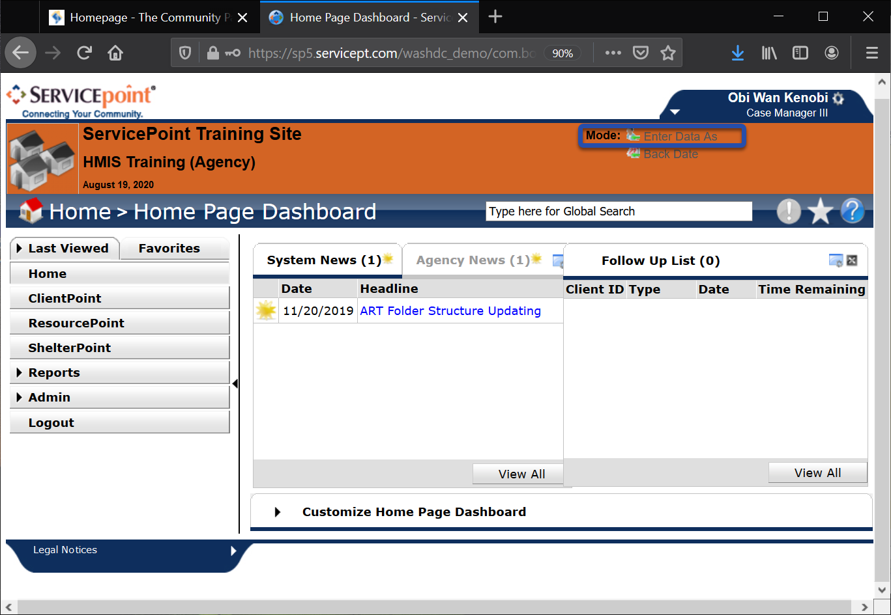
How to Enter Data As – Step 1
When you log into HMIS, go to the top right corner and click on the Enter Data As button

Slide 30
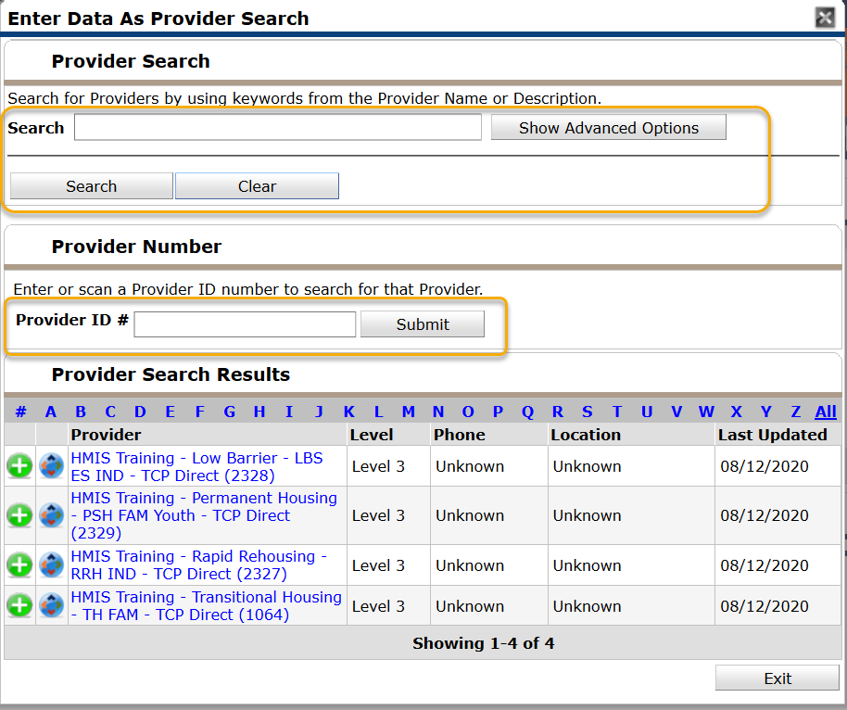
How to Enter Data As – Step 2
Find the program you are going to be doing data entry as.
You can search in the search box
You can type in the provider id
You can look through the list of options for the correct provider

Slide 31
How to Enter Data As – Step 3
When you find the correct program, click the green plus sign.

Slide 32
How to Enter Data As – Step 4
When you click the green plus sign, the name of the provider you will be doing data entry as will appear next to Enter Data As.
To remove the EDA click on the name of the provider (blue text).

Slide 34
Introduction to ClientPoint
ClientPoint is used by most Agencies in order to document program stays, case plans, services provided, and case managers.
The primary method of tracking program stays in ClientPoint is Entry/Exits.

Slide 35
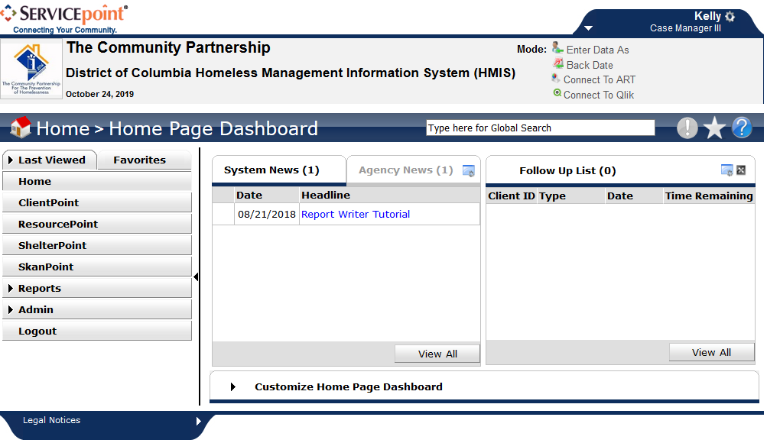

Slide 36
The Entry/Exit Workflow
Tracking clients served by a given provider using Program Entry Date and Program Exit is an Entry/Exit Workflow.
Programs contributing data to the DC HMIS that use an Entry/Exit Workflow include:
Emergency and Temporary Shelters for Families;
Temporary Shelters for Singles;
Transitional Housing Programs for Families and Singles;
Permanent Supportive Housing Programs for Families and Singles; and
Rapid Rehousing Programs for Families and Singles.
If you are unsure which program type you operate, please contact the HMIS Helpdesk.

Slide 37
What does Entry mean for my project type?
Street Outreach:
Date of first contact with the client
Emergency Shelter:
Night the client first stayed in shelter
Transitional Housing:
Date the client moves into the residential project (first night in residence)
Permanent Housing including Rapid Re-housing:
Date client was admitted into project
To be admitted indicates the following factors have been met:
Information provided by the client or from the referral indicates they meet the criteria for admission
The client has indicated they want to be housed in this project
The client is able to access services and housing through the project. The expectation is the project has a housing opening or expects to have on in a reasonably short amount of time
Supportive Services Only, Day Shelters, Homelessness Prevention, Coordinated Entry:
Date the client first began working with the project and generally received the first provision of service.
Notes:
Project Start or Entry means different things for different project types.

Slide 38
The Entry/Exit Workflow
Entering a client into your program
Searching for Client
Creating the entry/exit
Client is staying in your program
Updates and Annual Assessments
Case Plans
Client exits your program
Exiting a client

Slide 39
Section 1: Entering a Client into your Program
You will need to search for a client in order to add the client to your program
You can search for the client by name, or if you know the client’s ID #, you can use that.
Part 1: Searching for a Client

Slide 40
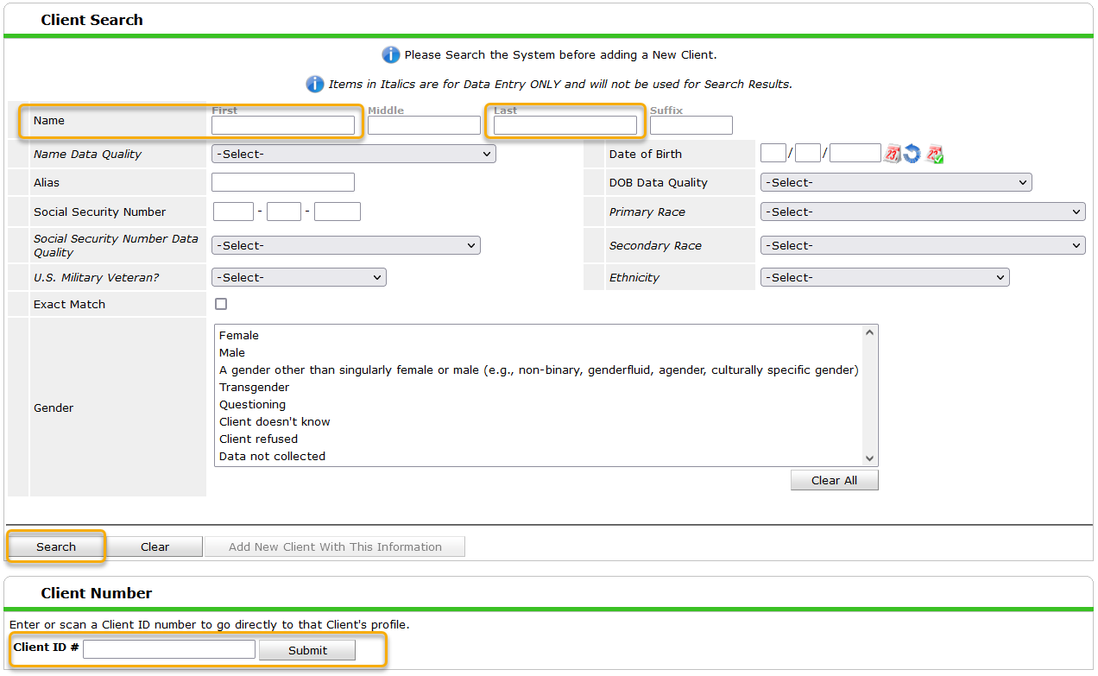

Slide 41
Creating a new client file
If you do not find a client record for the client you are serving, you will need to create a new client record.
This is done from the Search box in ClientPoint.

Slide 42
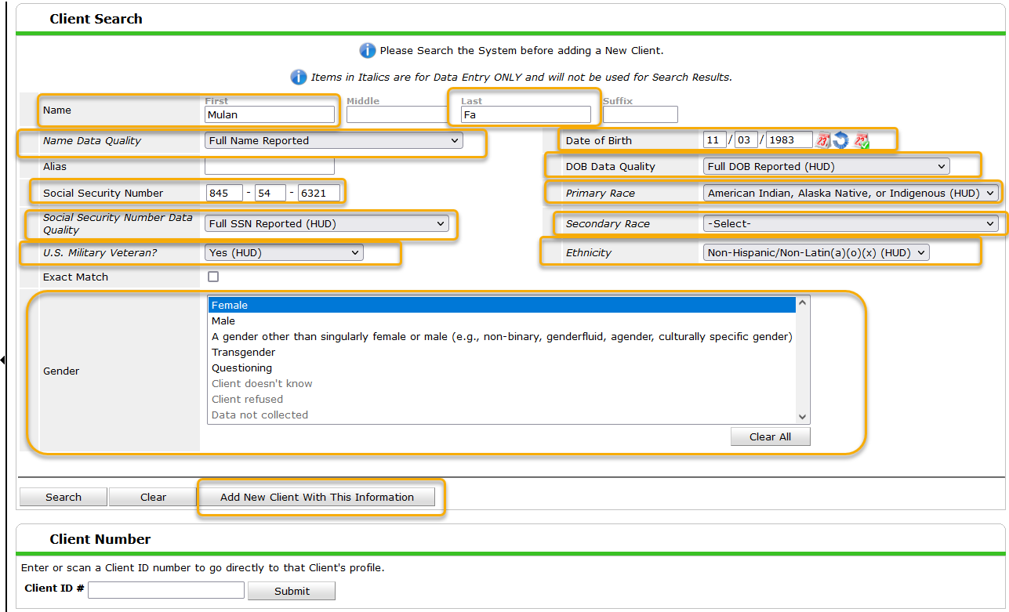
Notes:
You MUST search for the client record before you are able to create a new client record.
You MUST enter all the information indicated BEFORE you click “Add New Client With This Information”

Slide 43
Section 1: Entering a Household into your Program
If there is any missing or incorrect information in the Client Record or Client Demographic sections, click the corresponding Edit Pencil(s) to make the necessary changes.

Slide 44
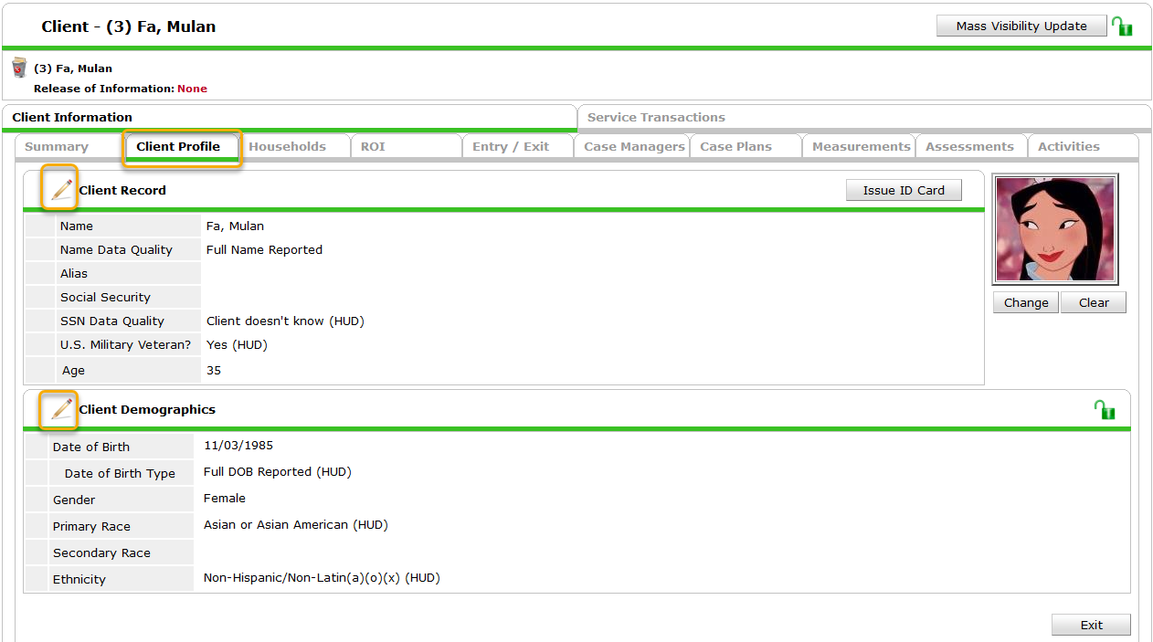

Slide 46
Section 1: Entering a Household into your Program
To document the client’s participation in the program, you need to create an Entry.
Navigate to the Entry/Exit Tab.
Part 3: Creating an Entry

Slide 47
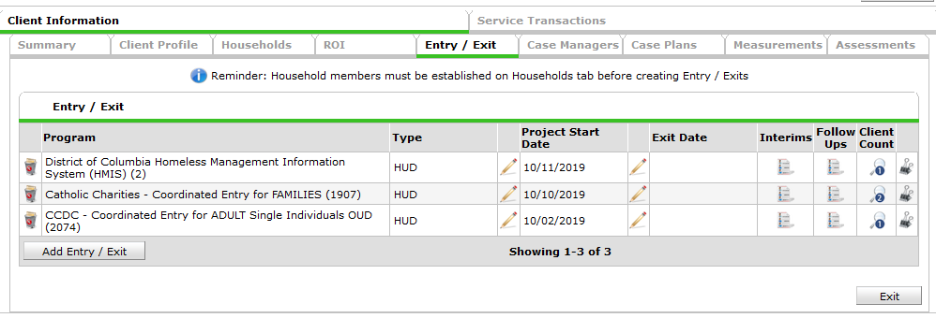
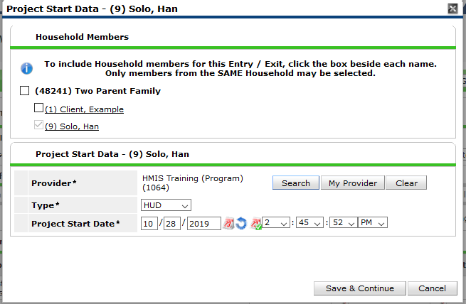
Click “Add Entry/Exit”
Choose the correct Type
Set the Project Start Date
Click Save & Continue

Slide 48
Section 1: Entering a Household into your Program
The Entry Assessment captures the universal data elements required by the Federal Partners and DC CoC as well as any program specific data elements required for your agency’s funding source.
Street Outreach, Emergency Shelters, and Safe Havens have a different set of assessments than all other project types. This is due to the way HUD captures Previous Living Situation information.
Most programs (Non SO, ES, or SH) have the DC Adults and Families Entry for HP TH PH SSO 2021 assessment. This is the required assessment for all HUD CoC, TCP, and DHS funded programs.
Part 4: The Entry Assessment

Slide 49
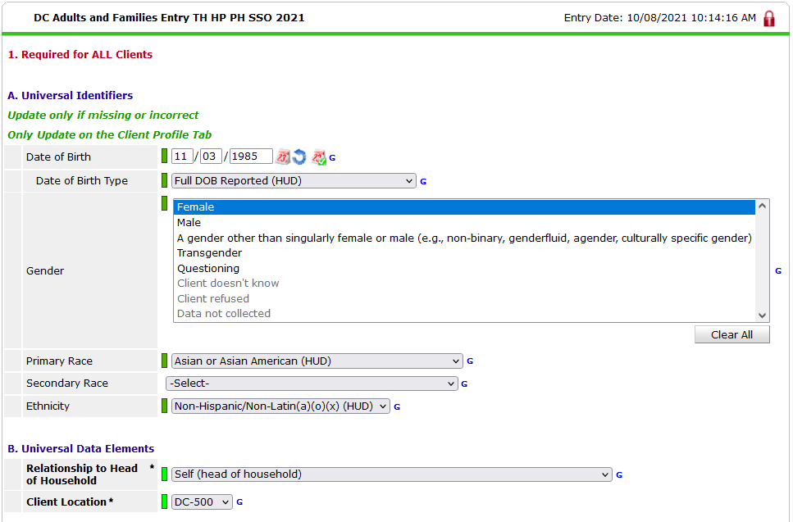
Notes:
IF the Client Demographics are missing, go back up to the Client Demographics box on the Client Profile tab and add the information there. This will ensure the information on is visible to ALL users, not just you. If that section is complete but your assessment is not, add the information to the assessment.
It is important that you read each question and answer it as of the program start date/entry date.

Slide 50
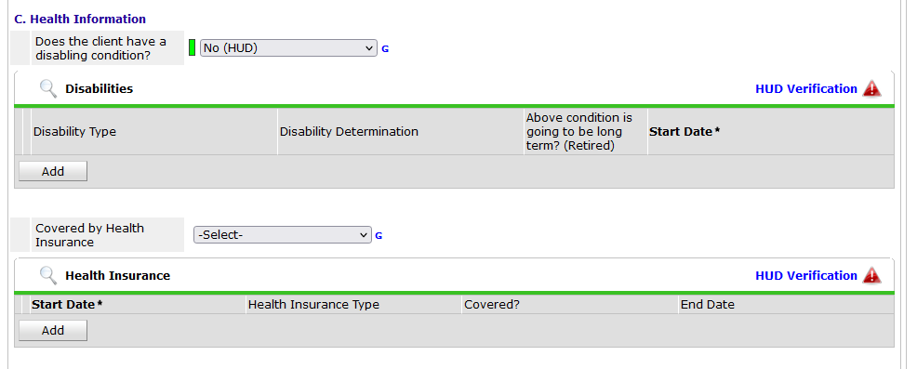
Health Information

Slide 51
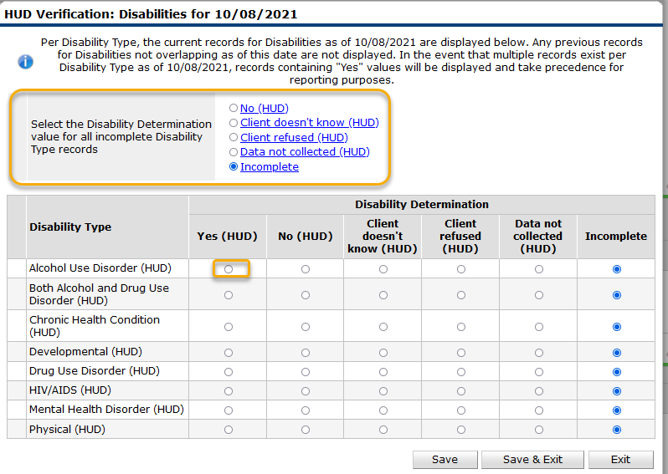
Begin by setting all incomplete values to “No”
For each Disability, add the disability type, determination, duration, and start date.
Once all Disabilities have been recorded via the HUD Verification, click “Save & Exit”

Slide 52
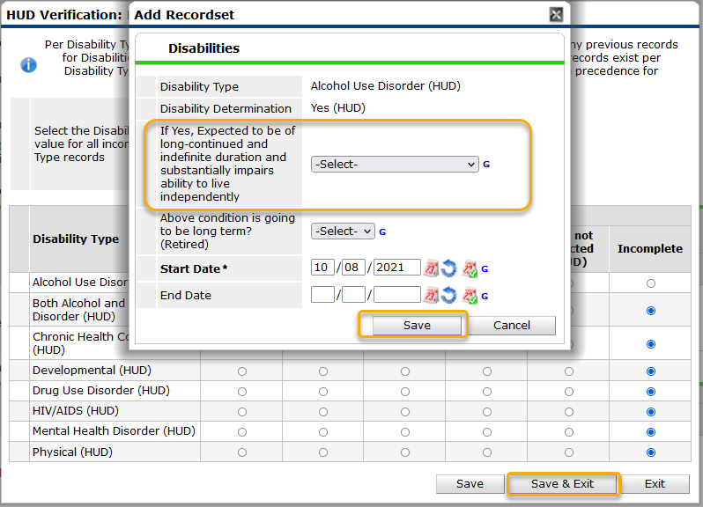
For each Disability, add the disability type, determination, duration, and start date.
Once all Disabilities have been recorded via the HUD Verification, click “Save & Exit”

Slide 53
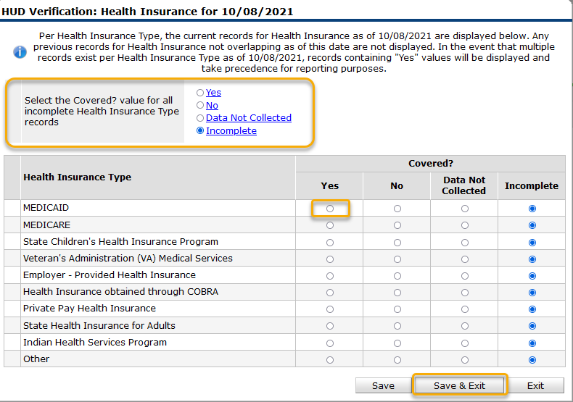
Begin by setting all incomplete values to “No”
For each source of Non-Cash Benefits, add the Non-Cash Benefit source, receiving benefit = “Yes”, and start date
Once all Non-Cash sources have been recorded via the HUD Verification, click “Save & Exit”

Slide 54
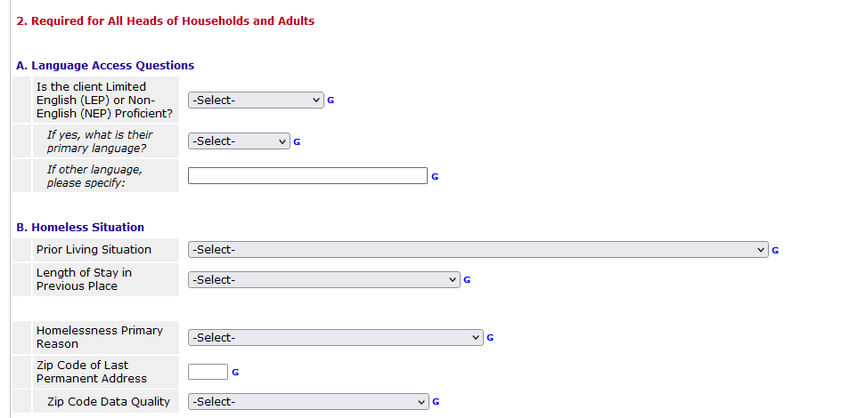
Questions for Adults and Heads of Household

Slide 55
Permanent Housing programs include:
Rapid Rehousing (including FRSP)
Permanent Supportive Housing
Other Permanent Housing
All Housing move-in dates need to be added fresh for your program.
If you see a date here, remove it by clicking the Blue Circle.

Slide 56
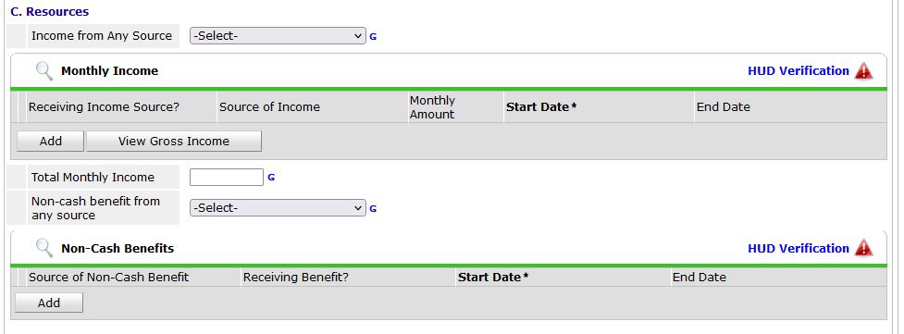

Slide 57
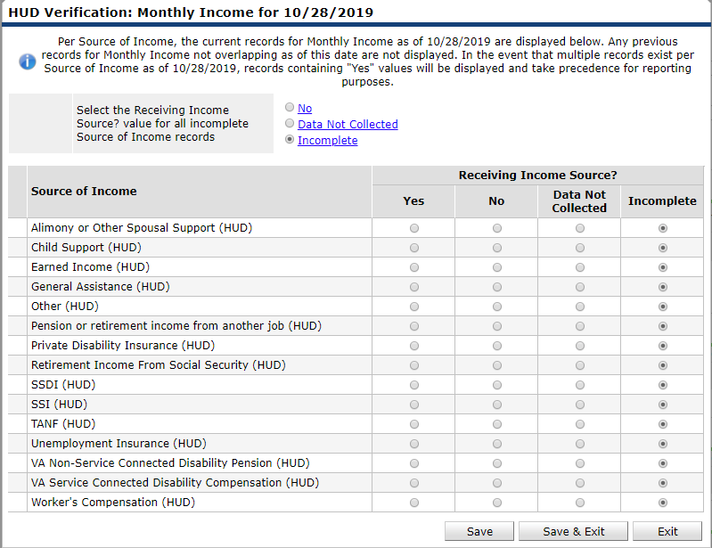
Begin by setting all incomplete values to “No”
For each source of income, add the income source, receiving income source = Yes, monthly amount and start date.
Once all income sources have been recorded via the HUD Verification, click “Save & Exit”

Slide 58
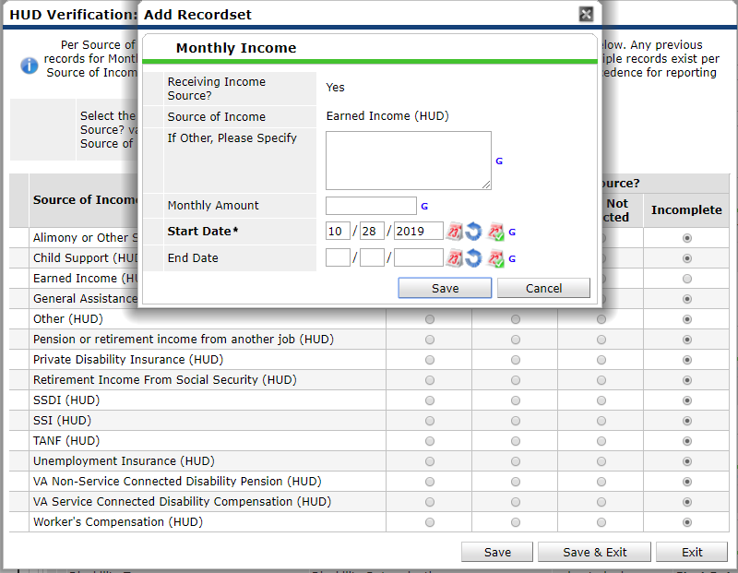
Begin by setting all incomplete values to “No”
For each source of income, add the income source, receiving income source = Yes, monthly amount and start date.
Once all income sources have been recorded via the HUD Verification, click “Save & Exit”

Slide 59
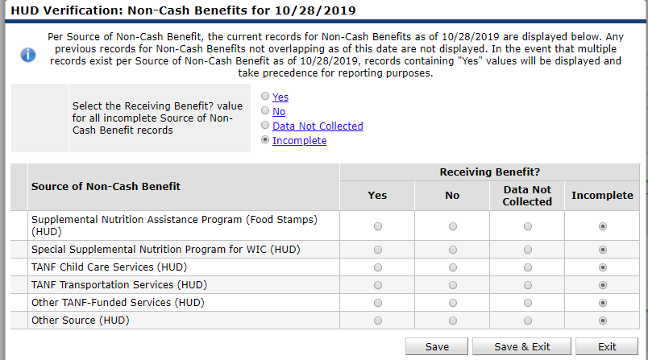
Begin by setting all incomplete values to “No”
For each source of Non-Cash Benefits, add the Non-Cash Benefit source, receiving benefit = “Yes”, and start date
Once all Non-Cash sources have been recorded via the HUD Verification, click “Save & Exit”

Slide 60
Currently in school –
Includes all forms of school
Vocational Training
Last Grade Completed

Slide 61
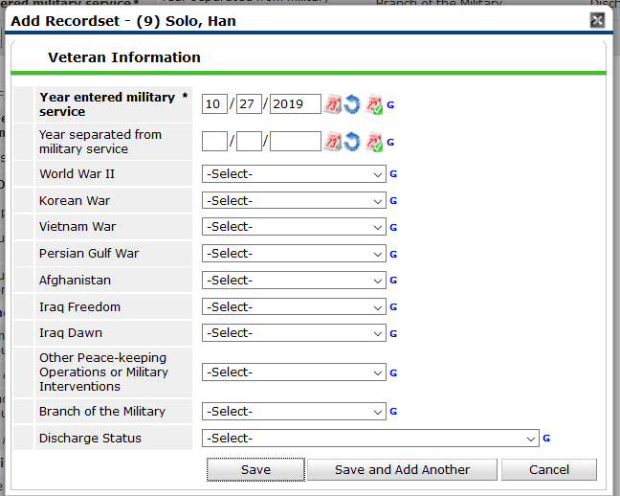
Anyone for whom you answer ‘yes’ to the question U.S. Military Veteran, you must also complete the Veteran Information sub-assessment.
Make sure to confirm or deny each of the different war eras.

Slide 62
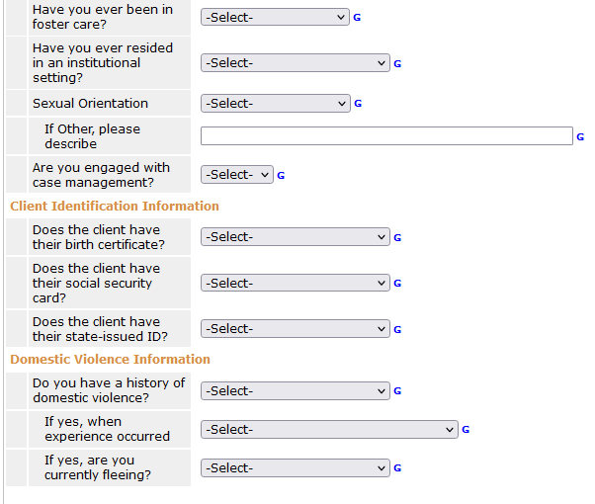
Client Information Continued

Slide 63
Client Contact Information
These are optional but encouraged
A good way to have all client information in one place, the HMIS client record.
Can add a client’s, family or friend’s or case manager’s information.

Slide 65
Section 2: The Household is in your Program
Updates: general, non-time-specific changes
Annual Assessments: required to be entered within +/- 30 days of the Head of Household’s Entry Anniversary for all clients.
Updates and Annual Assessments have fewer questions to complete and/or update compared to the Entry Assessment.
If you do not complete these, the system does not recognize the change in income and non-cash benefits that occur.
Part 1: Interim Reviews
Notes:
Your program should not need to use the Annual assessment, but updates should be used.

Slide 66
Creating an Interim Review

Slide 67
Creating an Interim Review

Slide 68
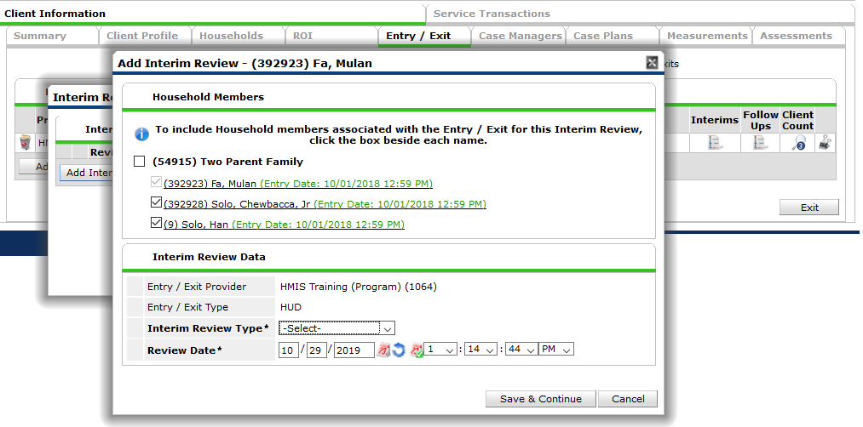
Creating an Interim Review
Notes:
Make sure all the
Updates should use the Interim Review Type “Update”
Annual Assessments should use the Interim Review Type “Annual Assessment”

Slide 69
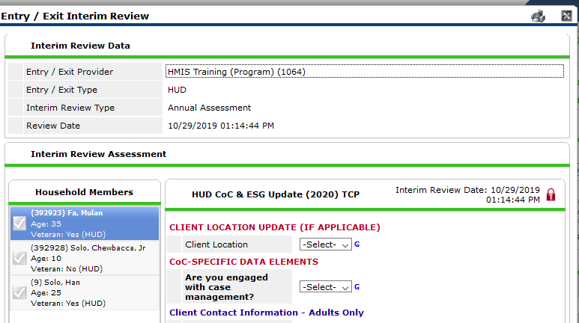
Interim Review Assessment
The questions in the Interim review(Update or Annual Assessment) will depend upon the funding source of your program.
Interim reviews generally contain data elements that may change over time.
Review all information in the Interim Review to ensure it is still up-to-date. Make updates as needed.

Slide 70
Data Elements commonly updated
Housing Move in Date
Income, Non-cash Benefits, Health Insurance
REQUIRED for Heads of Household in:
Permanent Supportive Housing
Rapid Rehousing
Other Permanent Housing
The Housing Move-in Date MAY be the same date as the Entry Date, but more likely it will occur AFTER the entry date.
IF it is on the same date as the Entry Date you MAY enter it on the Entry Assessment.
If it is AFTER the Entry Date, you MUST enter it in an Update.
If information in a sub-assessment has changed, we need to end the old information, and create new, accurate information.
We do not want to Delete any information that used to be correct.
We will add an End Date to the information that is no longer true, and then Add a new line in the sub-assessment with the new information.

Slide 71
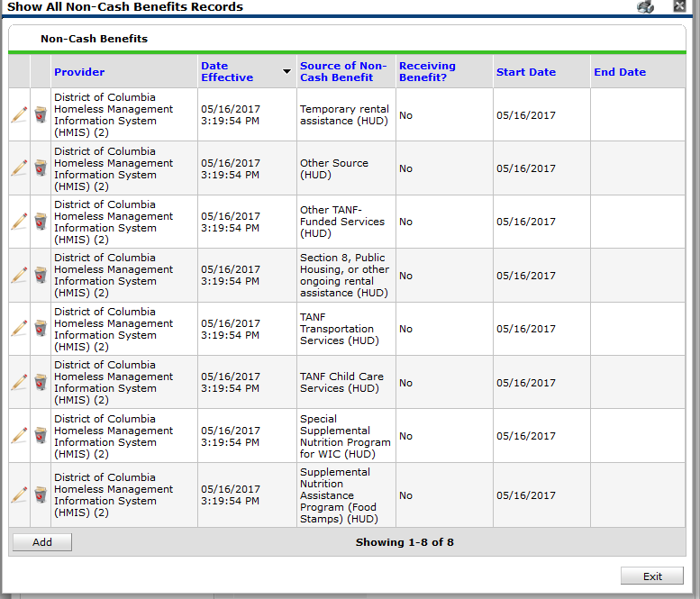
Here we have the details of the Non-Cash Benefits sub-assessment.
In my update, I find out that the client now has Food Stamps. I will want to update this information in HMIS.

Slide 72
Here we have the details of the Non-Cash Benefits sub-assessment.
In my update, I find out that the client now has Food Stamps. I will want to update this information in HMIS.
This information is no longer true. I will add an End Date to this record for yesterday.

Slide 73
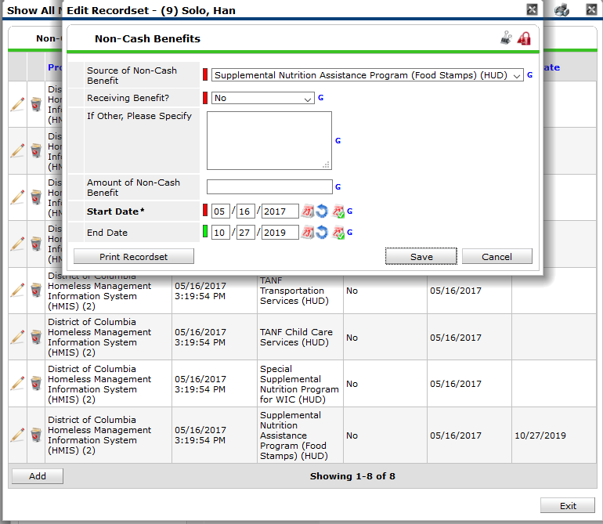
Here we have the details of the Non-Cash Benefits sub-assessment.
In my update, I find out that the client now has Food Stamps. I will want to update this information in HMIS.
This information is no longer true. I will add an End Date to this record for yesterday.
Once the End Date has been added, I will need to Add a new record for Food Stamps.

Slide 74
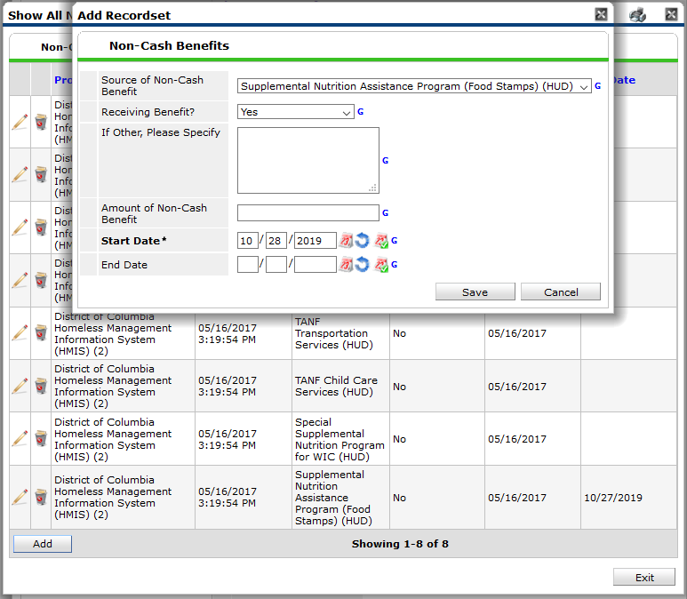
Here we have the details of the Non-Cash Benefits sub-assessment.
In my update, I find out that the client now has Food Stamps. I will want to update this information in HMIS.
This information is no longer true. I will add an End Date to this record for yesterday.
Once the End Date has been added, I will need to Add a new record for Food Stamps.
Since the client is receiving food stamps now, I answer “Receiving Benefit” = “Yes.
The Start Date = today’s date.
Notes:
This way there is not an overlap in the Sub-assessment where a client appears to be both receiving and not receiving Food Stamps.

Slide 76
Section 2: The Client is in your Program
Case Plans are required for DHS and TCP funded programs
There are multiple parts to case plans – detailed in the following slides.
Part 2: Case Plans
Notes:
In order for a client to be considered engaged in case management, they need to have a SPDAT or 4 interactions – services or case notes. It behooves Shelters to document as much as possible so that way you get credit for your work!
You should also document when a client refuses service – so even if the client refuses service 4 times in the month, they would still count as a client you attempted to engage. As long as you have documented those attempts in HMIS.
This is DHS’s standard for who has received case management, and in some cases this dictates which clients are counted in billing for services.

Slide 77
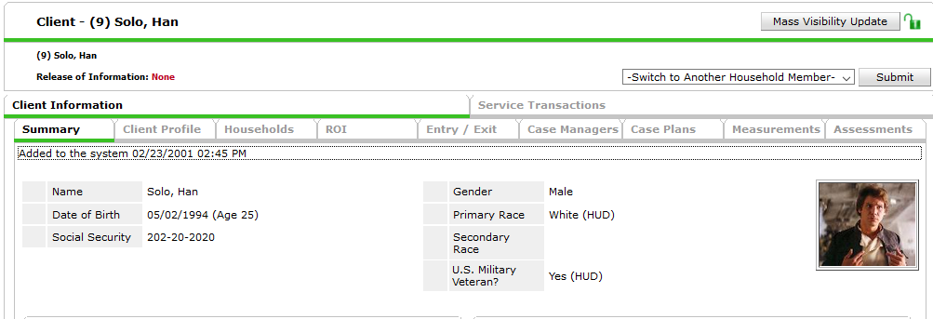
Adding a Case Manager
Step One: Go the Case Managers tab on the client profile screen:
This will take you to the Case Managers data entry screen.

Slide 78
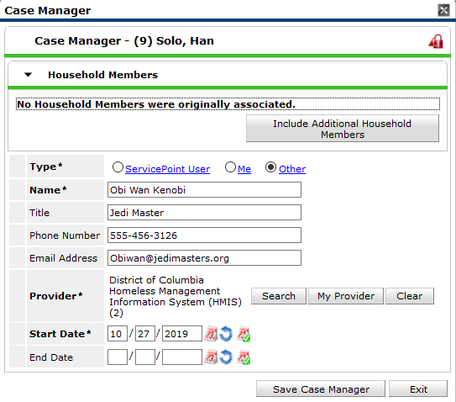
Choose whether the Case Manager is a ServicePoint User, Yourself, or someone else.
Complete the contact information
Click Save Case Manager

Slide 79
Case Manager FAQs
Can I add more than one case manager to a client’s case manager tab?
Yes. In some cases a provider may have a case manager and other service staff person such as a housing specialist or employment specialist working with a given client.
How do I indicate that a case manager is no longer working with a given client?
The case managers data entry screen has Start Date and End Date Fields to indicate when a case manager begins and ends working with a given client. This is where a case manager can indicate that he is no longer working with a client.

Slide 80
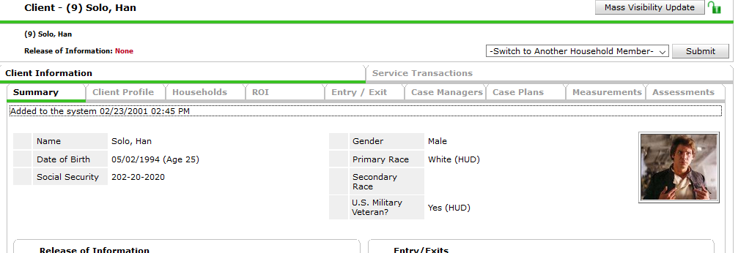
Step One: Go the Case Plans tab in ClientPoint:

Slide 81
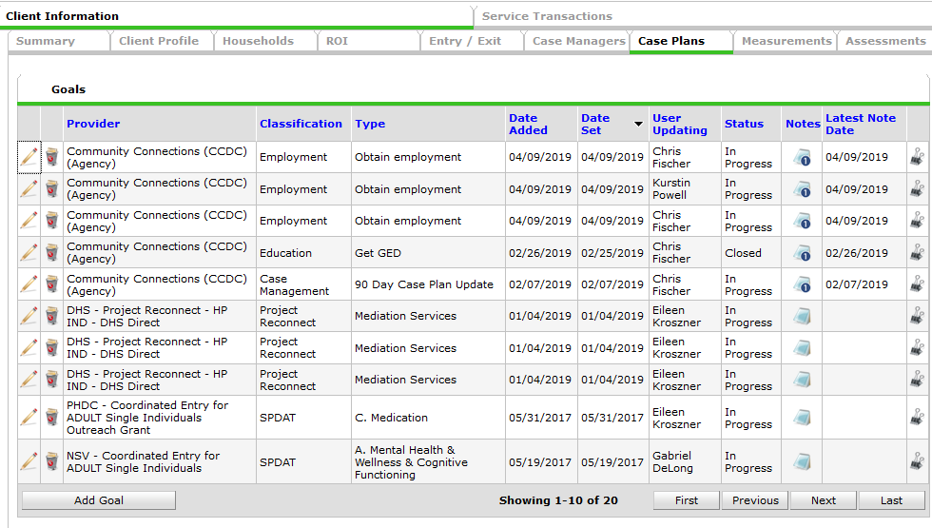
Step Two: On the Goals Screen click Add Goal:

Slide 82
Complete all the fields in the Goal Pop-up box.
Once complete, click “Add Goal”

Slide 83
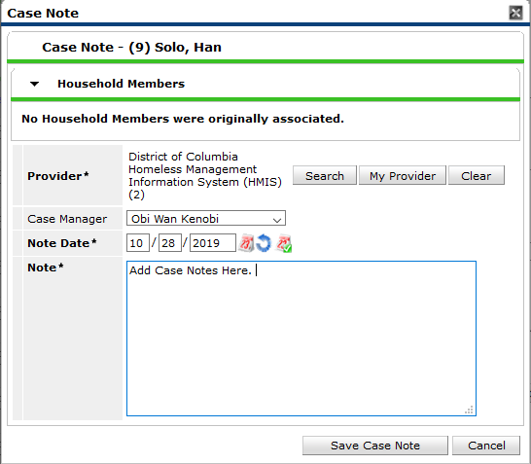
Case Notes

Slide 84
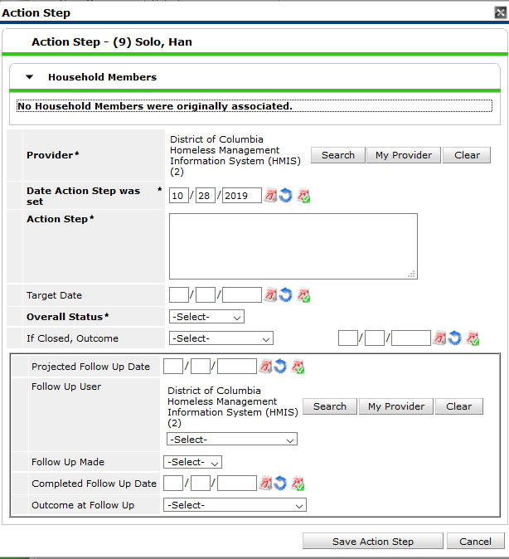
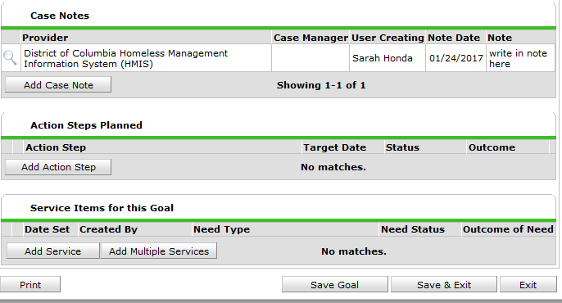
Action Steps

Slide 85
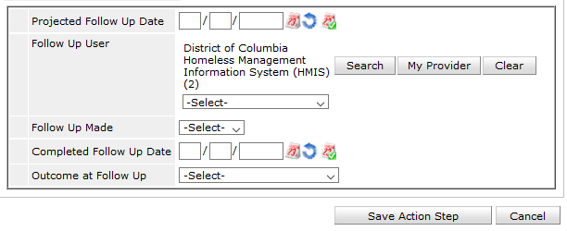
Goal Follow ups
Goals and action steps have fields that allow case managers to indicate the date they plan to follow up with a client (Projected Follow Up Date), the staff person who will be following up (Follow Up User) the date the follow up was actually made (Completed Follow Up Date), and the outcome at follow up (Outcome at Follow Up):

Slide 86
Updating Goals and Action Steps FAQ
What if a goal or action step requires follow up more than once?
Case managers can reset the projected follow update, completed follow up date, and outcome at follow up at each follow up.
If the client does not reach the goal by the Target Date, you can reset the target date to a new date instead of creating a new goal.

Slide 87
Ending a Goal
Goals and action steps have fields that allow case managers to indicate the status of a goal (Overall Status), and the outcome and date the goal was closed out (If Closed, Outcome and Date Field):
Please note: Action Steps are the action items a client needs to accomplish in order to achieve a larger goal, so all Action Steps should be closed out on or before the date the goal they support is closed.

Slide 89
Part 3: The Client leaves your Program
Part 1: Exiting a single client
Once a client has exited your program, you will need to create an exit in HMIS.

Slide 90
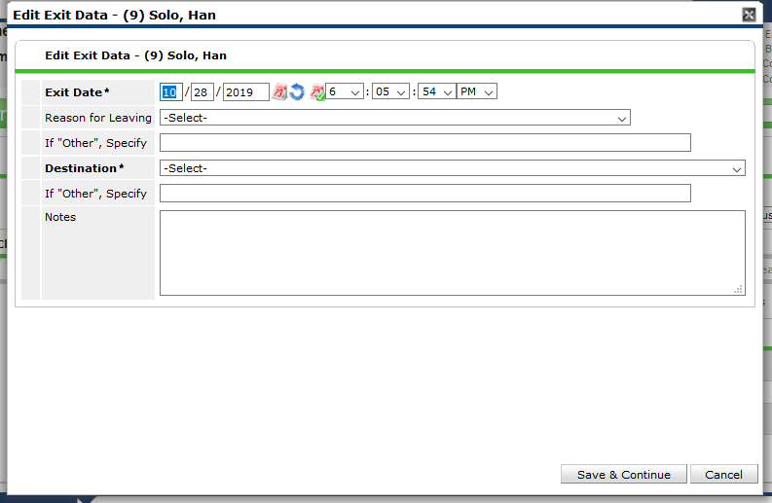
Set the exit date to the date the client left your program.
Next Set the exit Destination. The destinations with “(VW)” next to them are specific to Virginia Williams.

Slide 91
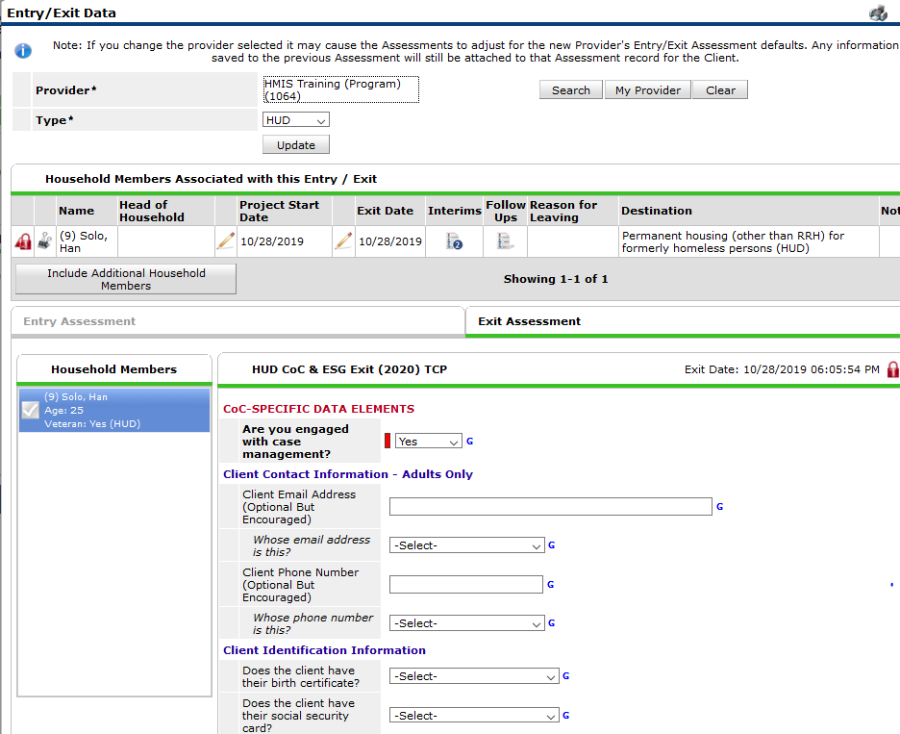
The Exit assessment is similar to the Update and Annual Assessment in that you can update the same fields if anything changes the day the client leaves your program
Depending on your program’s funding source, you may have additional questions that only appear at Exit.
Be sure to read the assessment carefully to ensure you are answering all questions.

Slide 93
Common Data Entry Errors
Exiting a client by mistake
Creating an Update instead of an Annual Assessment

Slide 94
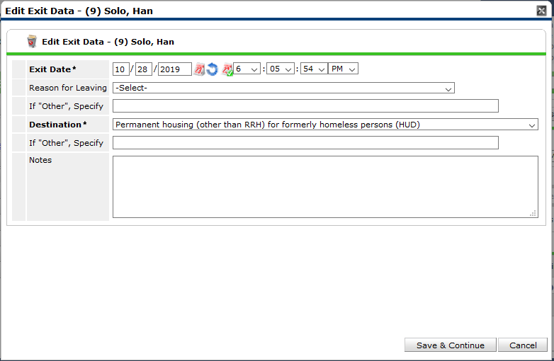
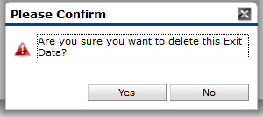
Exiting a Client by Mistake
Sometimes we exit a client when we did not mean to.
This can be fixed by deleting the exit. First we must click the Exit Edit Pencil.
Then we click the Trash can in the Edit Exit Data pop-up.
Click “Yes” to confirm and delete the exit.

Slide 95
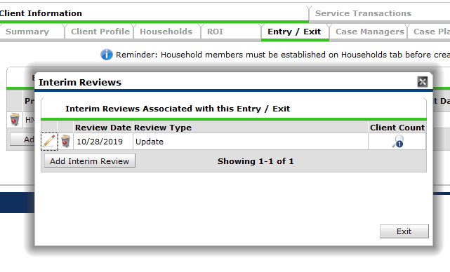
Creating an Update instead of an Annual Assessment
Sometimes we choose the wrong type of Interim Review.
Here I meant to enter an Annual Review but made an Update instead.
This can be fixed by updating the Interim Review Type.
Click the Edit Pencil for the Update.

Slide 96
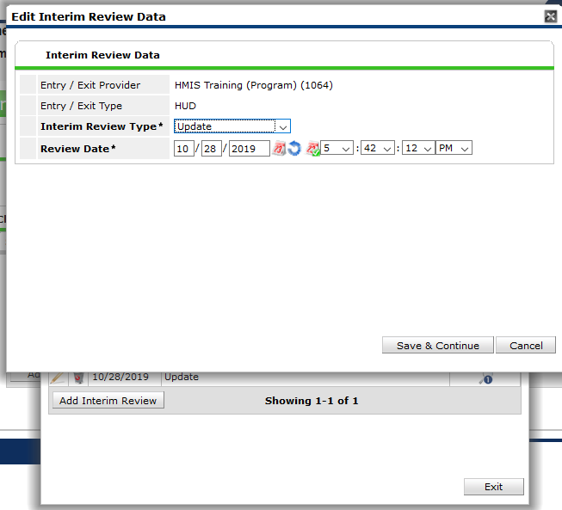
Change the Interim Review Type to Annual Assessment
Click Save & Continue.
If you have already made all your updates to the Assessment, click Save & Exit.

Slide 97
Additional Resources
Agency Admins
TCP Website
Helpdesk
Trainings
Notes:
https://tcp.tfaforms.net/4811776

Slide 98
Agency Admins
Each Agency has a designated Agency Admin
This person handles most questions about HMIS from users in their Agency
They also send information to users about training requirements, data quality fixes, and reporting needs.
Have a question? Contact your Agency Admin first!
We will keep a current list of Agency Admins in System News for your reference – download it so you have a copy if you need it.

Slide 99
TCP Website
https://community-partnership.org
Contains:
Training registration links
Slidedecks
User guides and How tos
Report guides

Slide 100
Helpdesk
hmis@community-partnership.org
Email the helpdesk with questions and we will provide answers and resources.
We respond within 2 business days.

Slide 101
HMIS Trainings
TCP hosts this set of trainings every month.
They are open to all, new user, seasoned veteran, or anywhere in between
Training registrations found at: https://community-partnership.org/events
Have questions about the trainings? Email the helpdesk!
We are developing plans for additional trainings in the future.

Slide 102
Next Steps
All who have completed this training will receive an automated email from GoToWebinar
This email will contain a link for your certificate of completion
It will also contain the link for the User Agreement
Users who do not have a current HMIS log in must sign the User Agreement.
At end of the Training Week, your Agency Admin will receive a list of all the staff who have successfully completed trainings this month.
The Agency Admin creates your user account
Once that is created and the User Agreement is signed TCP can add the license to activate.

Slide 103
Thanks for participating!
Questions?
HMIS Help-Desk Email: hmis@community-partnership.org

