Slide 1
2024 Point-in-Time Count Results
District of Columbia Continuum of Care

Slide 2
What is the PIT Count?
The Point-in-Time Count or “PIT Count” creates a snapshot of the scope and scale of homelessness in the District at a single point in time.
Required of every community that receives federal homelessness assistance funds from the U.S. Dept. of Housing and Urban Development (HUD).
The Community Partnership (TCP) has coordinated and conducted the count on behalf of the District of Columbia Continuum of Care since 2001.
PIT data is used locally to plan programming and to track progress made toward goals outlined in Homeward DC
This year’s PIT was held on Wednesday, January 24th.
PIT is comprised of data from the CoC’s Homeless Management Information System (HMIS) and direct counts/surveys with people who are experiencing homeless in non-HMIS programs, including DV, and those who were sleeping in an unsheltered location on the night of PIT.
Notes:
Molly

Slide 3
PIT Count Results - Totals
539 family households, comprised of 1,656 persons, and 3,960 unaccompanied individuals were counted in 2024 for a total of 5,616 persons.
84% of all persons were in a shelter or transitional housing program on the night of PIT.
Nearly all persons counted in an unsheltered location were counted in unaccompanied adults with only five (5) households with children counted.
 | Emergency Shelter | Transitional Housing | Unsheltered | Total
Family Households | 289 | 245 | 5 | 539
Persons in Families | 979 | 665 | 12 | 1,656
Unaccompanied Individuals | 2,329 | 743 | 888 | 3,960
Totals Persons | 3,308 | 1,408 | 900 | 5,616
The table above includes child-only households. In 2024 there were ten (10) unaccompanied minors counted in unaccompanied individuals and no child-only family households (i.e. a pregnant or parenting minors) counted in 2024. Transitional Housing includes four (4) veterans in a “Safe Haven” program.

Slide 4
PIT Count Results - Changes
Between the 2023 and 2024 counts, the total number of persons increased by 14.1% or 694 persons.
The count of unaccompanied individuals is up 5.6%
The number of persons in families increased by 41.3%
The count of total persons is still lower than pre-pandemic levels, comparing the 2020 and 2024 counts, the total number is down -12.0% or 764 persons.
The count of unaccompanied individuals is relatively flat with a 0.3% increase from 2020
The number of persons in families is down -31.9% since 2020

Slide 5
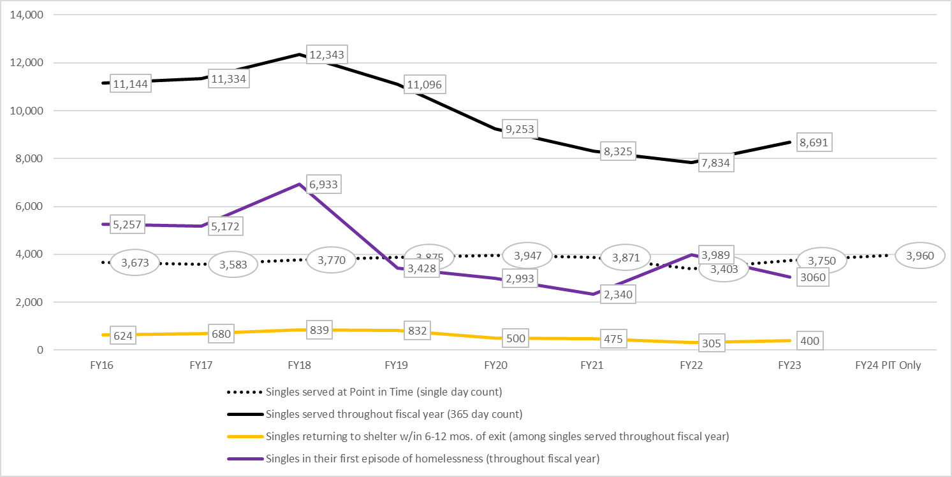
Annual System Use and Inflow
Notes:
Molly

Slide 6
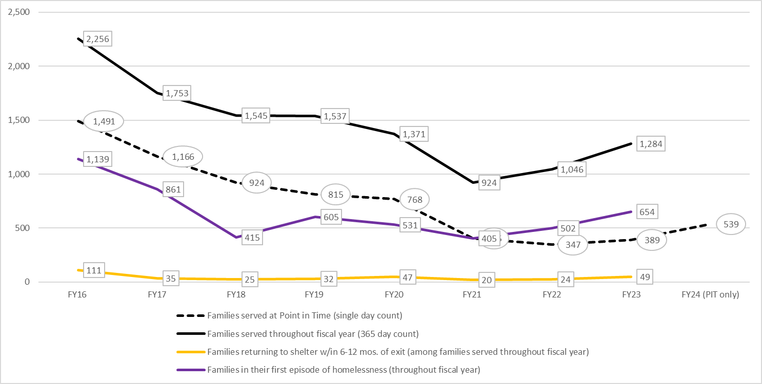
Annual System Use and Inflow
Notes:
Molly

Slide 7
Context for the 2024 Count
The increase in the number of persons over the past two years may be a readjustment following the expiration of additional resources made available to those facing a housing crisis during the public health emergency.
In FY23, 40 percent of unaccompanied individuals served – or around 3,460 unique individuals – and 703 unique families (35 percent of families served during the fiscal year) were either new to the CoC or returned to the CoC after exiting to permanent housing at least two years prior.
New inflow continues to thwart the District’s efforts to reduce the number of individuals and family households experiencing homelessness.
Notes:
Molly

Slide 8
Shelter & Transitional Housing Unaccompanied Individuals
The number of unaccompanied individuals using emergency shelter or transitional housing increased by 5.6% between the 2023 and 2024 PIT Counts.
Since the 2020 PIT Count, the number of unaccompanied individuals is down -9.7% in emergency shelter programs and up 4.1% in transitional housing programs.
9 unaccompanied minors were counted in a CoC emergency shelter program specific for that population.
 | Unaccompanied Minors | Unaccompanied Adults | Total | % Change 2023 – 2024 | % Change 2020 – 2024
Emergency Shelter | 9 | 2,320 | 2,329 | .6% | -9.7%
Transitional Housing | 0 | 743 | 743 | 20.8% | 4.1%
Transitional Housing includes four (4) veterans in a “Safe Haven” program.

Slide 9
Shelter & Transitional Housing Families
The number of families using emergency shelter or transition housing increased by 38.6% between the 2023 and 2024 PIT Counts.
Since the 2020 PIT Count, the number of families is down -50.4% in emergency shelter programs and up 32.4% in transitional housing.
There were no pregnant or parenting minors counted in 2024.
 | Children in Families | Adults in Families | Family Units | % Change Units 2023 – 2024 | % Change Units 2020 – 2024
Emergency Shelter | 613 | 366 | 289 | 37.0% | -50.4%
Transitional Housing | 414 | 251 | 245 | 38.4% | 32.4%

Slide 10
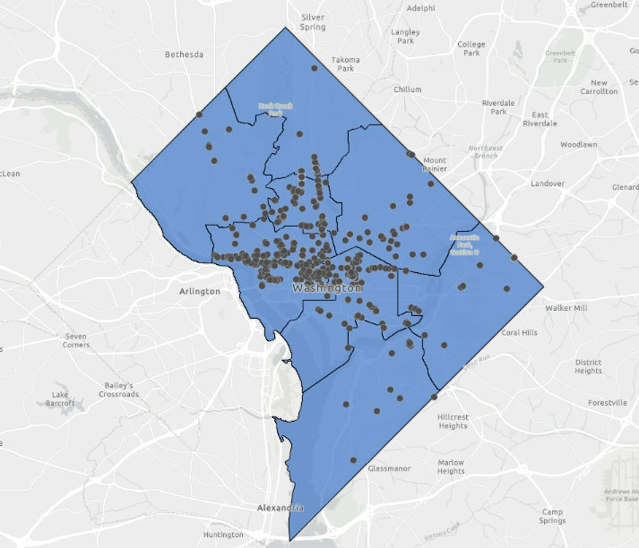
Unsheltered Persons
900 persons were counted via the PIT Count survey in an unsheltered location on the night of PIT.
887 unaccompanied adults (comprising 866 households without any children, i.e. an adult couple staying together)
1 unaccompanied minor, age 17
5 families comprised of 5 adults and 7 children under the age of 17.
The number of unaccompanied persons was up 8.2% since PIT 2023 and 36.0% since the pre-pandemic count in 2020.
The distribution of survey engagements shows clusters where there are large numbers of unsheltered individuals in the areas of Downtown, Union Station, Georgetown, Foggy Bottom, and Golden Triangle.

Slide 11
Race & Ethnicity
 | Unaccompanied Persons | Persons in Families
American Indian, Alaska Native or Indigenous | 0.4% | 0.1%
American Indian, Alaska Native or Indigenous & Hispanic/Latin(a)(e)(o) | 0.5% | 0.2%
Asian or Asian American | 1.3% | 0.1%
Asian or Asian American & Hispanic/Latin(a)(e)(o) | 0.1% | 0.0%
Black, African American or African | 75.8% | 90.3%
Black, African American or African & Hispanic/Latin(a)(e)(o) | 2.0% | 3.6%
Hispanic/Latin(a)(e)(o) | 1.7% | 0.8%
Middle Eastern or North African | 0.03% | 0.2%
Middle Eastern or North African & Hispanic/Latin(a)(e)(o) | 0.1% | 0.0%
Native Hawaiian or Pacific Islander | 0.2% | 0.3%
Native Hawaiian or Pacific Islander & Hispanic/Latin(a)(e)(o) | 0.1% | 0.1%
White | 9.2% | 0.4%
White & Hispanic/Latin(a)(e)(o) | 5.7% | 2.1%
Multi-Racial (NOT Hispanic/Latin(a)(e)(o)) | 0.9% | 0.9%
Multi-Racial & Hispanic/Latin(a)(e)(o) | 1.9% | 0.9%
The 2024 PIT count marks the first year of a change in HUD data standards for collecting race and ethnicity as a single measure.
93 percent of all persons (including children) at PIT 2024 identified with a race and ethnicity other than White alone, including White and Hispanic/Latin(a)(e)(o). Compared to District residents at large, that number is just 62 percent.*
8% of persons in families and 12% of all unaccompanied individuals identified as Hispanic/ Latin(a)(e)(o) by selecting one of those options.
* U.S. Census Bureau, American Community Survey (ACS) 2023 https://www.census.gov/quickfacts/DC
Notes:
Tyrell
Race @ PIT is all adults in families and unaccompanied.

Slide 12
Age
 | Unaccompanied Individuals | Family HoH
13 to 17 (Households with only children) | 0.3% | 0.0%
18 to 24 (TAYs) | 10.4% | 25.6%
25 to 34 | 18.9% | 45.8%
35 to 44 | 20.4% | 22.6%
45 to 54 | 17.1% | 5.0%
55+ (Seniors) | 32.9% | 0.9%
The median age for unaccompanied individuals was 45 (46 for men and 45 for women) and was 30 for heads of family households.
The unaccompanied individual population skewed slightly younger each year over the past two counts, down from a median age of 49 in 2022 and 47 last year, while the adults in families skewed older from 28 in 2023 to 30 in this year’s count.
The above table includes just the designated heads of households for families to denote the number of families in the CoC where the family would be eligible for youth specific resource.
Notes:
Tyrell

Slide 13
Gender
From year to year, the difference in the gender makeup of unaccompanied adults compared to that of adults in families stayed relatively consistent.
Women make up 86 percent of adults in families, whereas those who identify as a man make up 70 percent of the unaccompanied individuals subsystem.
In general, unaccompanied adults report more variation in gender identity with around two (2) percent of all unaccompanied adults (92 persons) identifying as a gender other than singularly a man or a woman, contrasted to only six (6) adults in families.
Notes:
Tyrell

Slide 14
Veterans
The PIT Count of veterans was down by five (5) persons in 2024 and down 96 persons, or -45%, since 2020.
In FY23, the CoC helped house 335 veterans – a 33 percent increase from FY22.
The majority of veterans were single adults and only four (4) were served by the family subsystem.

Slide 15
Life Experiences
 | Unaccompanied Adults | Adults in Families
Survivor of Domestic Violence | 25.7% | 50.5%
Limited/No English Proficiency | 10.9% | 4.0%
Formerly in Foster Care | 10.3% | 10.6%
Resided in an Institutional Setting | 37.5% | 10.8%
As has been the case for several years in the District’s PIT Count, surviving domestic or intimate partner violence is the most reported life experience among adults in families.
While this was reported by 24% of unaccompanied individuals, when breaking the individuals’ subsystem down by gender, domestic violence was reported at a rate of almost 50% for unaccompanied women as opposed to 14% for men.

Slide 16
Disabling Conditions and Chronic Homelessness
As has been the case in previous years, the disabling conditions tracked at PIT have been more prevalent among unaccompanied adults than adults in families.
The lower prevalence of disabling conditions among adults in families coupled with the efforts to exit families from shelter to housing quickly have translated to a markedly low rate of chronic homelessness among families in the District.
 | Unaccompanied Adults | Adults in Families
Substance Abuse (SA) History | 20.3% | 0.2%
History of Mental Illness (MI) | 34.1% | 9.5%
Dual Diagnosis (SA & MI) | 12.2% | 0.2%
Chronic Health Problem | 19.8% | 2.3%
Developmental Disability | 5.4% | 0.0%
Living with HIV/AIDS | 3.4% | 0.2%
Physical Disability | 17.0% | 2.6%
Experiencing Chronic Homelessness | 43.2% | 3.5%
Chronic homelessness is experienced, as defined by HUD, when an adult person has been unsheltered or in emergency shelter for a year or more or has had four or more episodes of homelessness in three years (which total at least 12 months), and who is living with a disabling condition. Rates of chronicity are calculated out of adults in emergency shelter, safe havens, or those who are unsheltered and do not include adults residing in transitional housing programs.
Notes:
Elisabeth
Factors like the slowing down of inflow into the system and housing placements slowing these may have affected the rate of chronicity at PIT for unaccompanied adults.

Slide 17
Income and Employment
Typically, adults in families report higher rates of income and employment compared to their counterparts in the unaccompanied individuals’ subsystem. This difference between household types is likely due to factors such as fewer disabling conditions and a younger average age among adults in families.
For those with income in both subsystems, however, a small majority report that a benefit is their primary (greatest) source as opposed to income from employment.
 | Unaccompanied Adults | Adults in Families
Employed | 10.1% | 29.4%
Receiving Income | 40.5% | 66.7%
Employment | 23.8% | 24.8%
Social Security/Retirement | 4.8% | 0.0%
SSI/SSDI (Disability Income) | 54.2% | 13.7%
TANF/Public Assistance | 9.1% | 56.9%
Other | 8.1% | 4.6%
Due to a calculation error, the above table was corrected on 5/23/2024 and differs from initial reports.
Notes:
Elisabeth
Factors like the slowing down of inflow into the system and housing placements slowing these may have affected the rate of chronicity at PIT for unaccompanied adults.

Slide 18
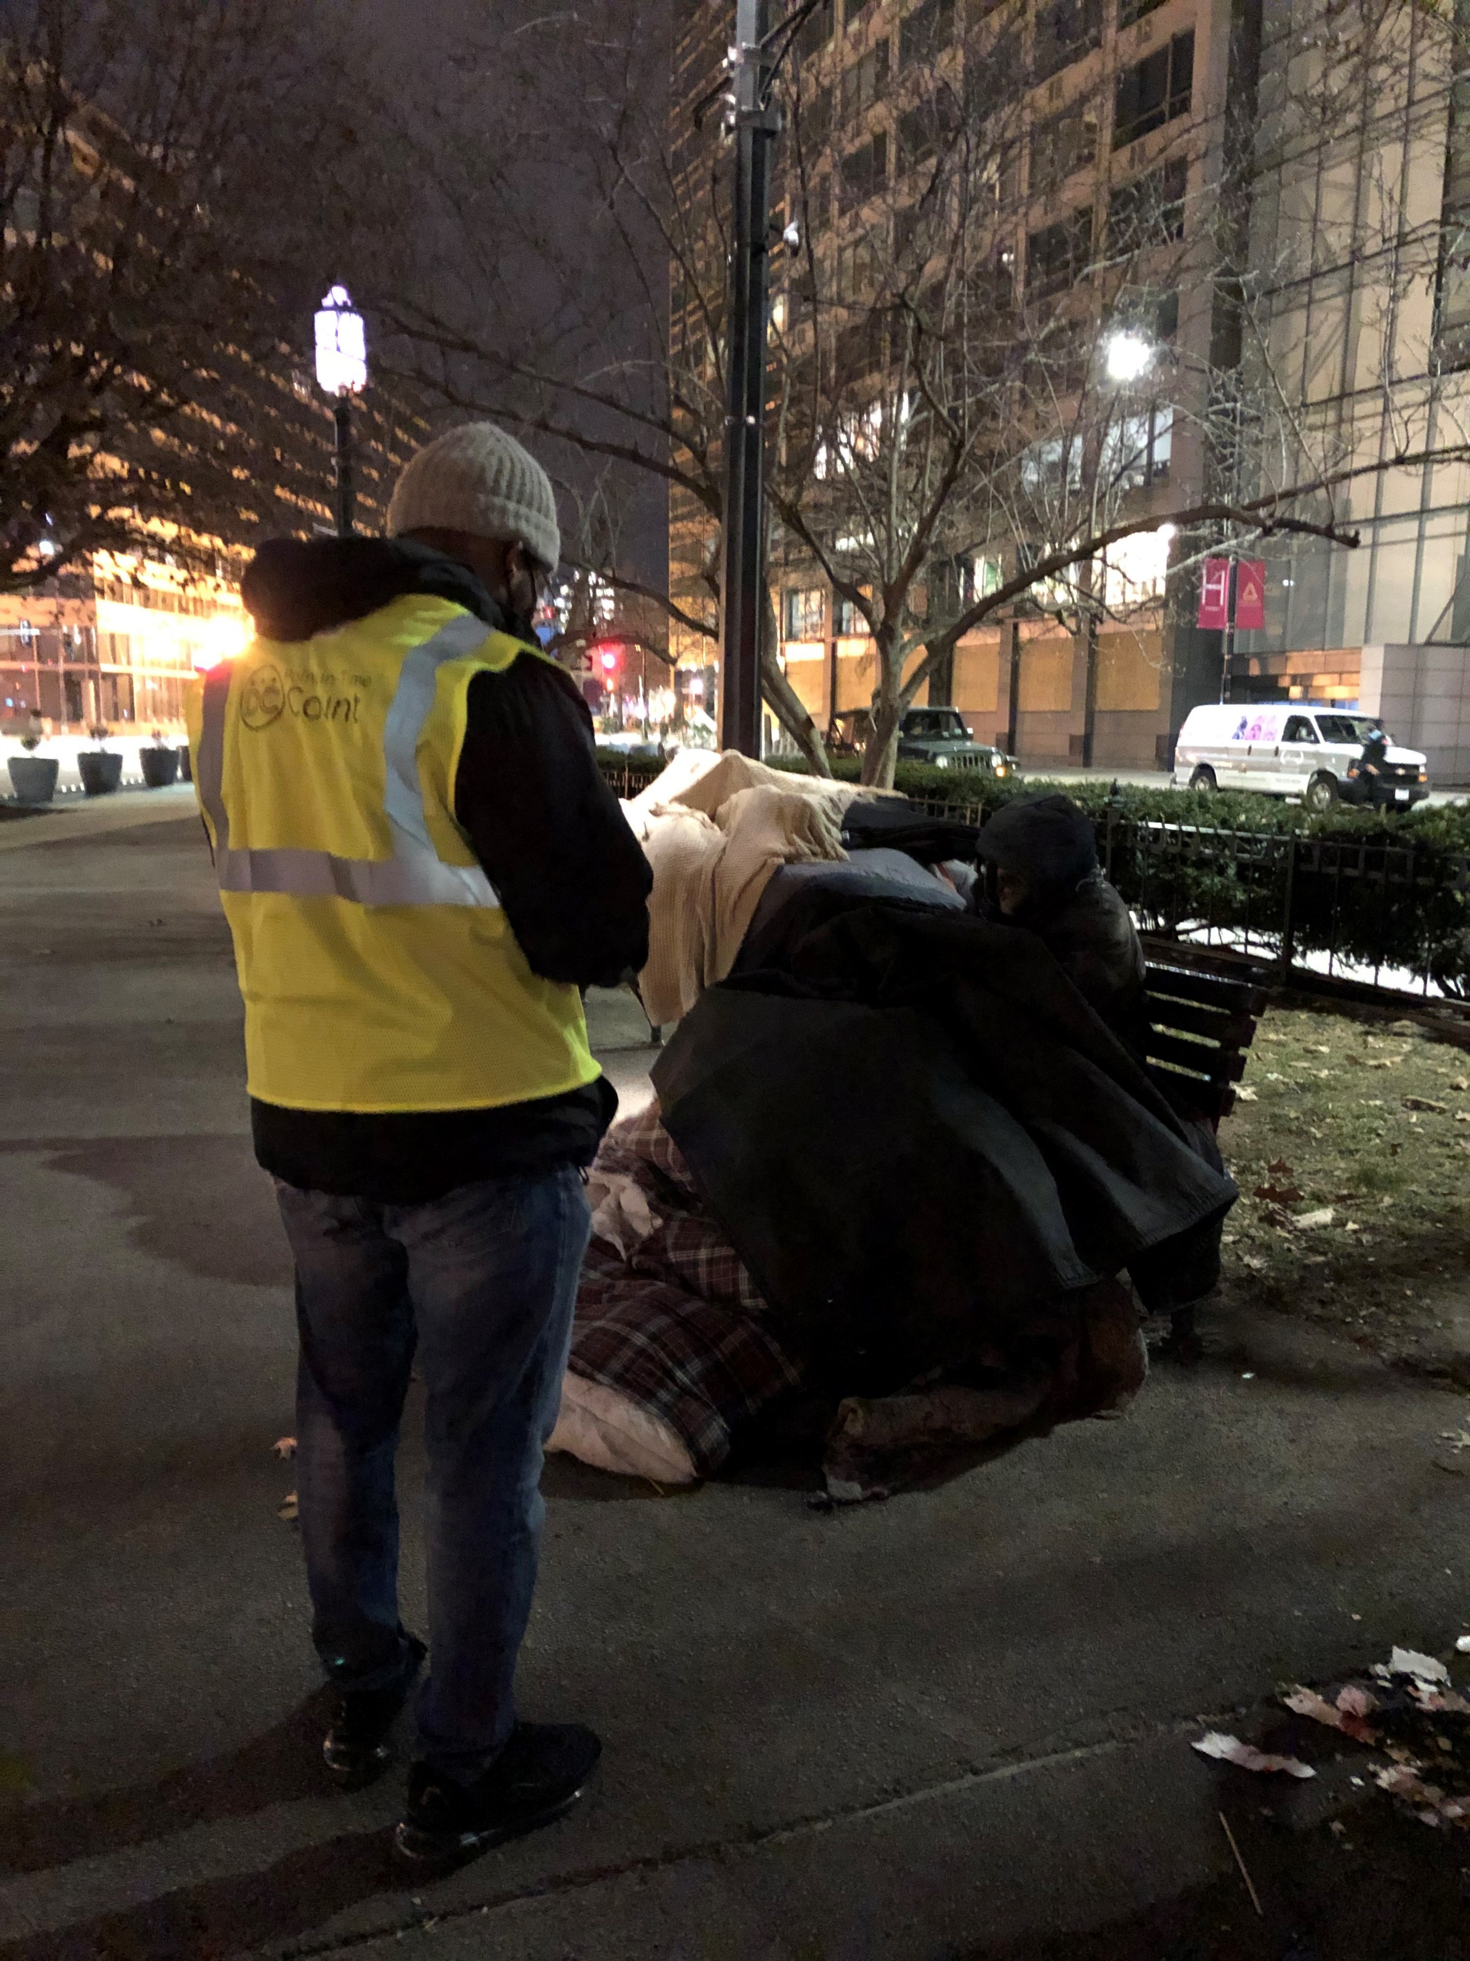
2024 PIT Count Results
For complete 2024 Point-in-Time Count results, visit The Community Partnership’s website to view the PIT Count dashboard.

Slide 19
2023 PIT Count Results
Questions?
Notes:
Elisabeth
Factors like the slowing down of inflow into the system and housing placements slowing these may have affected the rate of chronicity at PIT for unaccompanied adults.

Slide 20
TCP Contacts
Tom Fredericksen | Chief of Policy & Programs
tfredericksen@community-partnership.org
Elisabeth Young | Deputy Chief of Policy and Programs
eyoung@community-partnership.org
Tyrell McQueen | Analyst
tmcqueen@community-partnership.org
Harish Sundararaman | Analyst
hsundararaman@community-partnership.org

