Slide 1
Shelter
WORKFLOW
HTTP://WWW.COMMUNITY-PARTNERSHIP.ORG/
5/17/2024

Slide 2
Shelter Entry Date and Shelter Exit is the Shelter Workflow
SHELTER WORKFLOW
Shelter programs contributing data to the DC HMIS that use an Entry/Exit Workflow include:
Emergency and Temporary Shelters

Slide 3
WHAT DOES ENTRY DATE MEAN FOR MY PROJECT TYPE?
Emergency Shelter :
Night the client first stayed in shelter

Slide 4
SHELTER WORKFLOW
Updates
Annual Assessments
Case Manager
Case Plans
Service Transactions
Entering a client/ household into your program
Client/household is staying in your program
Exiting a single client
Exiting a household
Close out Case Manager
Close out Case Plans
Select Unit List
Searching for Client
Add new client
Client/ household exits your program

Slide 5
Shelters
HTTP://WWW.COMMUNITY-PARTNERSHIP.ORG/
5/17/2024

Slide 6
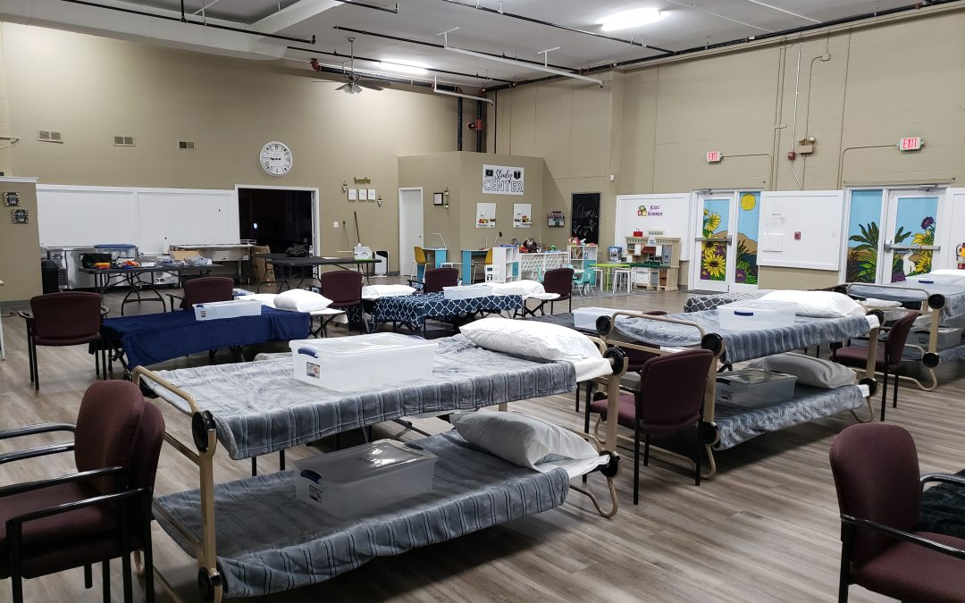
Shelters
This module allows users to perform the following tasks:
Check Client In
Express Check In
Transmit Today’s Check Out List

Slide 7
Shelter Dashboard
Remember to EDA
Select Unit List
Select Check Client In

Slide 8
First – Search for client
By name – using partial or full name
Client ID #
Client Results are located at the bottom if the
client is in the system
(Verify the information is correct)
Click the pencil icon or name of client to access the client's record.
CLIENT SEARCH
Searching for a Client (your head of
household)

Slide 9
By name – using partial or full name

Slide 10
Search by Client ID #
List of results will appear at the bottom

Slide 11
Creating a new client file
If you do not find a client record for the client you are serving, you will need to create a new client record.
Once you have input the clients information, click “Search”
No results- click “Add New Client With This Information”

Slide 12
Shelter Inventory
View who is currently checked into shelter
Add new client to shelter
Click the green plus button to select a bed

Slide 13
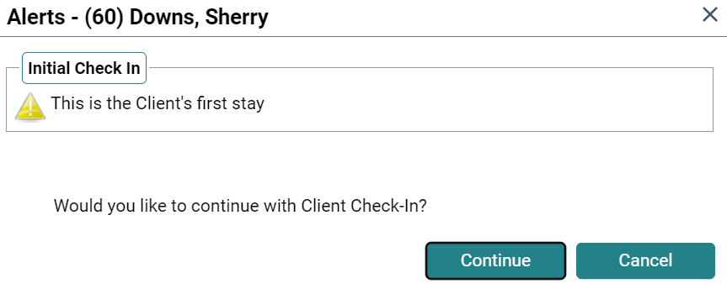
Alerts
Alerts – are notices for different things in the system

Slide 14
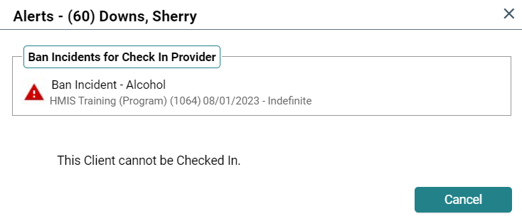
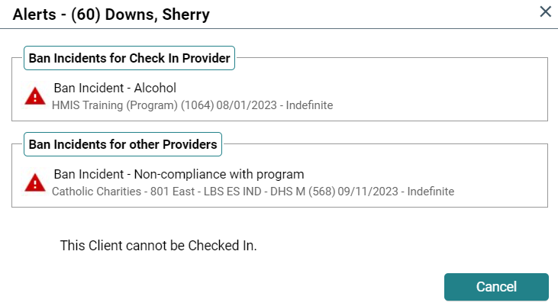
Alerts
If an incident has been created in the clients profile – the alert will pop-up as you try to enter them into shelter

Slide 15
Entry
HTTP://WWW.COMMUNITY-PARTNERSHIP.ORG/
5/17/2024

Slide 16
The Entry Assessment
The Entry Assessment captures the universal data elements required by the Federal Partners and DC CoC as well as any program specific data elements required for your agency’s funding source.
**required assessment for all HUD CoC, TCP, and DHS funded programs.**

Slide 17
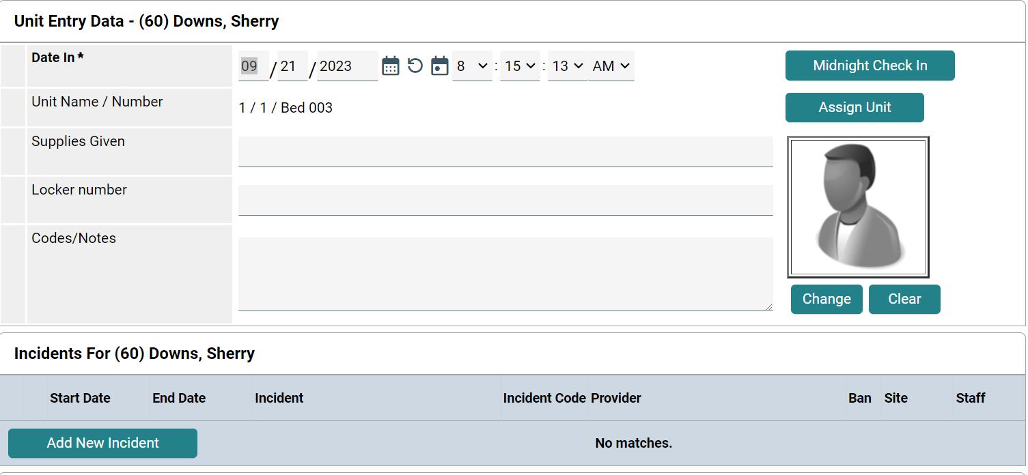
Creating an Entry
To document the client/household’s participation in the program, you need to create an Entry.
Located on the Check In
Scroll Down

Slide 18
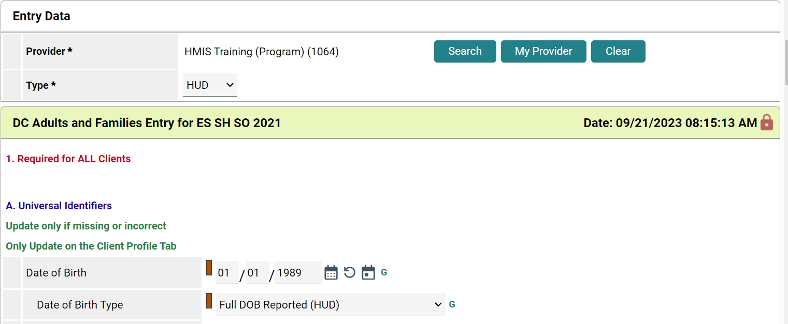
Defaults to Provider and Type – Make sure you are in the correct EDA
Start date is the same date as shelter stay

Slide 19
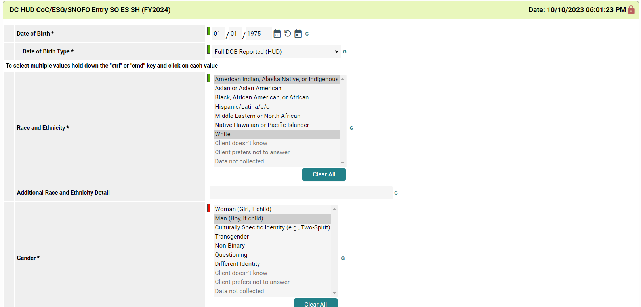
Entry Assessment

Slide 20
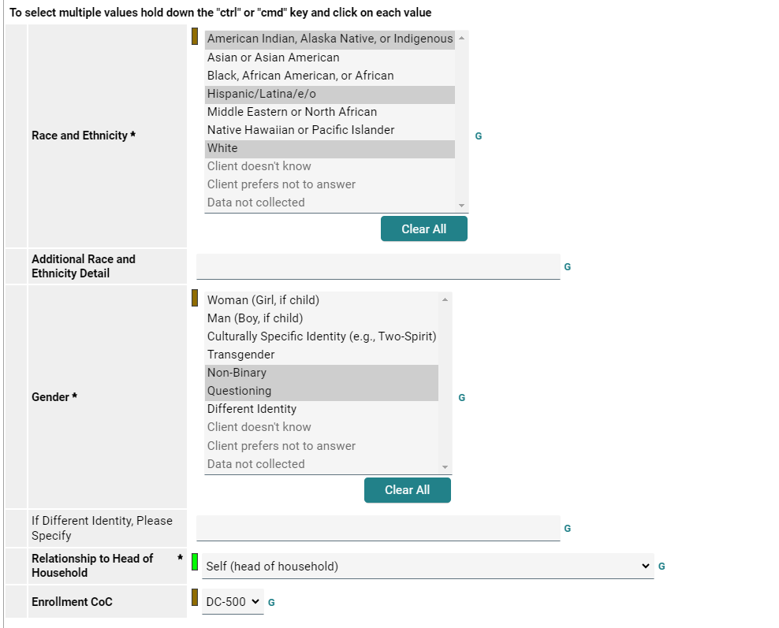
If the information does not carryover - you will need to complete all sections for the client.
If the sections are already complete – verify that the information is still correct
Sections that are bold* - are required
HTTP://WWW.COMMUNITY-PARTNERSHIP.ORG/
5/17/2024

Slide 21
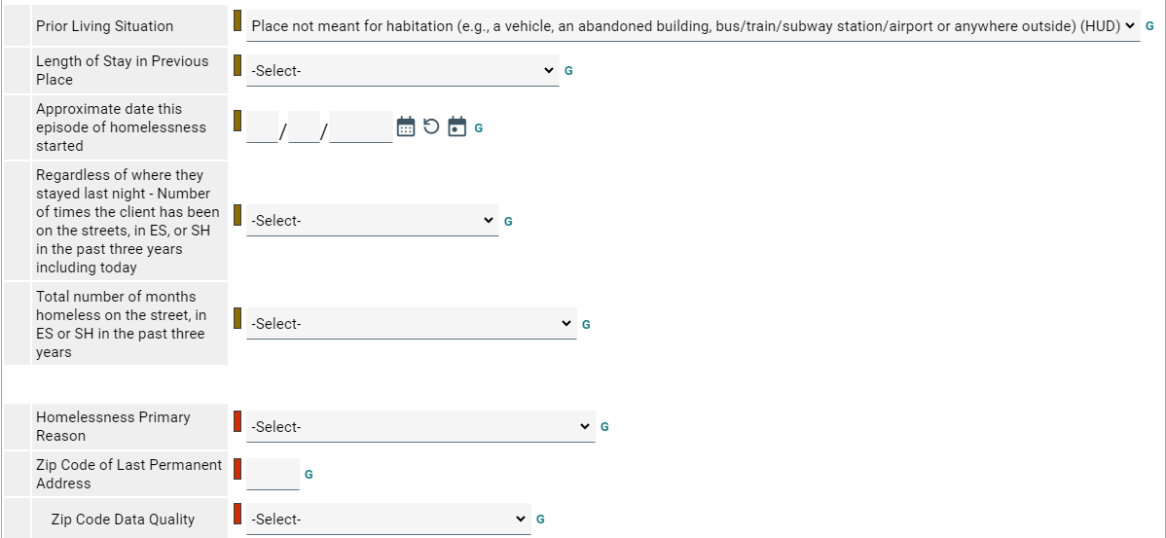
Prior Living Situation section needs to be completed every time for the client
**Approximate date section is for this episode only
Clicking on the questions will provide a questions description
Complete this section for Head of Household and Adults only
HTTP://WWW.COMMUNITY-PARTNERSHIP.ORG/
5/17/2024

Slide 22
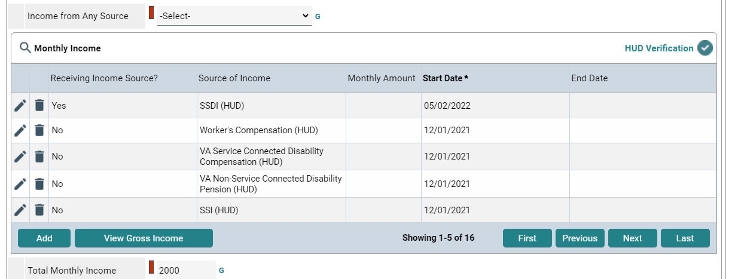
Income section requires the completion of the HUD verification sub assessment
HTTP://WWW.COMMUNITY-PARTNERSHIP.ORG/
5/17/2024

Slide 23
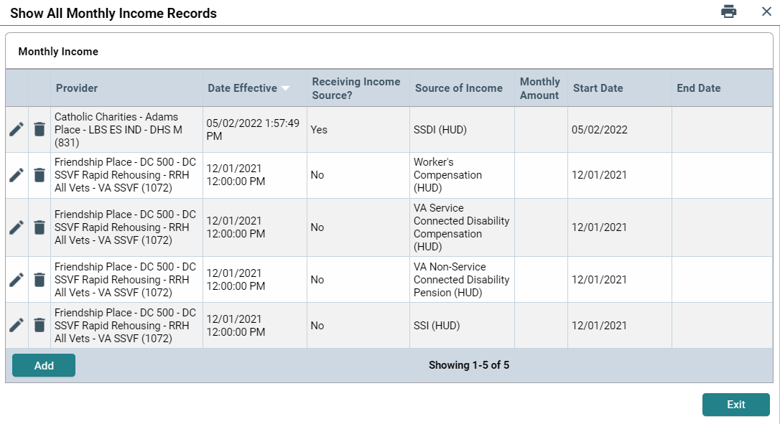
Sub Assessment Already Completed
Use magnifying glass to see full list
Verify what is still current for the client
If the information has changed – put an end date on the change section
End date is the day prior

Slide 24
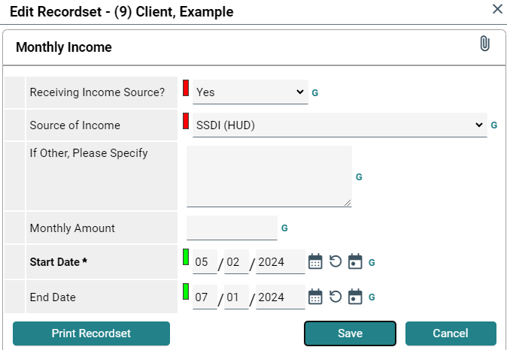
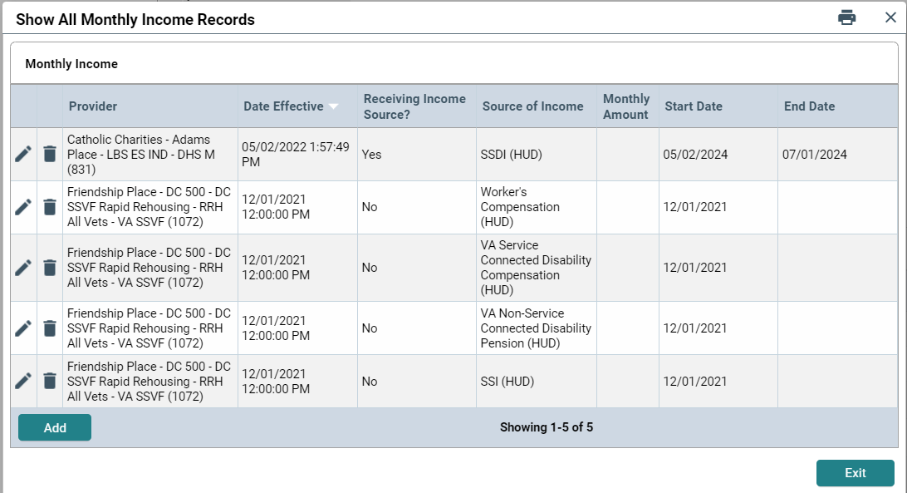
End date = day prior
HTTP://WWW.COMMUNITY-PARTNERSHIP.ORG/
5/17/2024

Slide 25
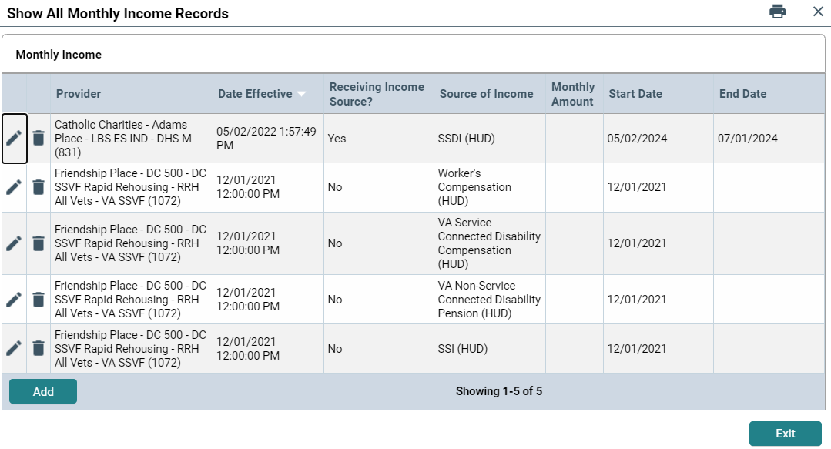
Click the Add button to start a new line with new information
HTTP://WWW.COMMUNITY-PARTNERSHIP.ORG/
5/17/2024

Slide 26
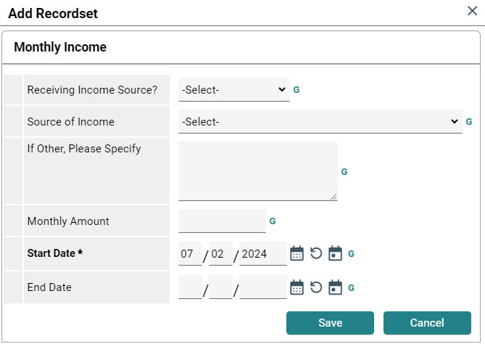
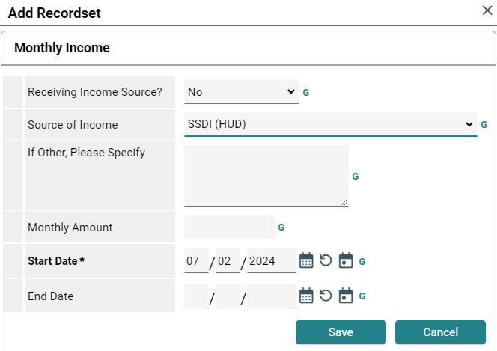
Use the drop down arrow to complete each section with new information
Start date is automatically added
HTTP://WWW.COMMUNITY-PARTNERSHIP.ORG/
5/17/2024

Slide 27
This section keeps track of the changes in information
Do not delete anything
HTTP://WWW.COMMUNITY-PARTNERSHIP.ORG/
5/17/2024

Slide 28
If there is a red triangle – the section is incomplete
HTTP://WWW.COMMUNITY-PARTNERSHIP.ORG/
5/17/2024

Slide 29
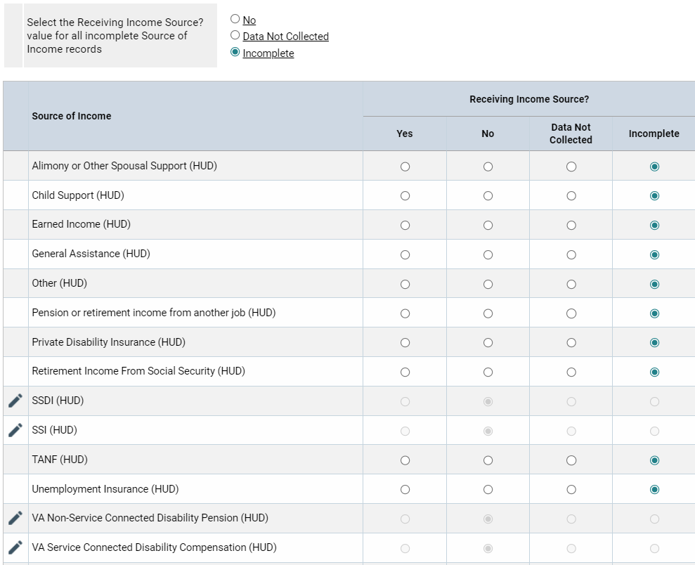
Data Not Collected and Incomplete will create errors in reporting
All answers should be Yes or No
HTTP://WWW.COMMUNITY-PARTNERSHIP.ORG/
5/17/2024

Slide 30
Once complete the red triangle will become a green checkmark
Entry
HTTP://WWW.COMMUNITY-PARTNERSHIP.ORG/
5/17/2024

Slide 31
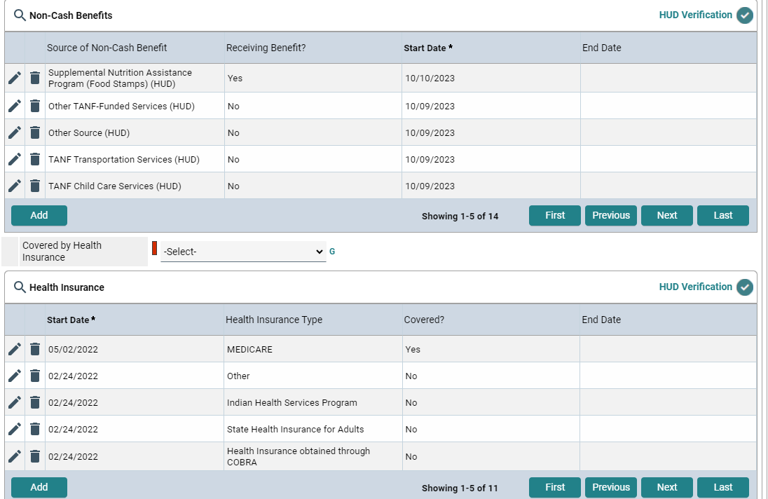
Non-Cash Benefits and Health Insurance are completed the same way as the Income section
In each section you want to see the green checkmark
Entry
HTTP://WWW.COMMUNITY-PARTNERSHIP.ORG/
5/17/2024

Slide 32
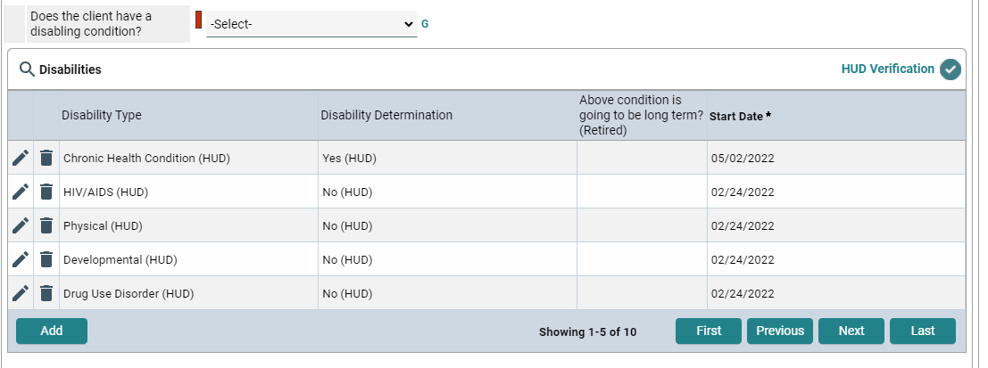
Disabilities, Income, Non-Cash Benefits and Health Insurance are completed the same way
In each section you want to see the green checkmark
Complete these sections for Head of Household and Adults only
HTTP://WWW.COMMUNITY-PARTNERSHIP.ORG/
5/17/2024

Slide 33
Translation Assistance Needed
Education Information
Foster Care
Institutional Setting
Sexual Orientation
Case Management
Birth Certificate
Social Security
State-issued ID

Slide 34
Anyone for whom you answer ‘Yes’ to the question U.S. Military Veteran, you must also complete the Veteran Information sub-assessment
Make sure to confirm or deny each of the different war eras
This section to be completed for All Adults
5/17/2024 53

Slide 35
Complete the Survivor of Domestic Violence section
If yes, complete all questions
If no, complete the first question only
Complete the Housing Move- in Date for Permanent Housing Programs
If you do not know the move-in date – complete this at a later date
If the section is complete and does not reflect your work with the client – clear out the information
Complete for Head of Household only
HTTP://WWW.COMMUNITY-PARTNERSHIP.ORG/
5/17/2024

Slide 36
For households – complete the assessment for each family members
Scroll up and select the next household member
Some sections are only required for Head of Household and Adults
Once the assessment has been completed for each family member
Click Save & Exit
HTTP://WWW.COMMUNITY-PARTNERSHIP.ORG/
5/17/2024

Slide 37
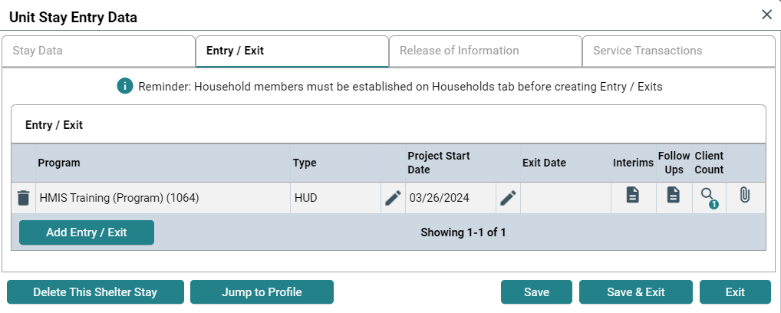
Assessment = Entry/Exit
Once the Entry Assessment is complete, the client will have an entry on the Entry/ Exit tab
This can be viewed by
clicking on the clients name, then tab to Entry/Exit
Or on the clients profile in Clients
The entry is system generated, there is nothing that needs to be done

Slide 38
Express Check In
HTTP://WWW.COMMUNITY-PARTNERSHIP.ORG/
5/17/2024

Slide 39
Express Check In
Check in multiple clients at one time
Give clients the first unit available

Slide 40
Express Check In
Scroll Down

Slide 41
Express Check In
Input the Client IDs
Automatically checks the client into a bed
Exit - when completed

Slide 42
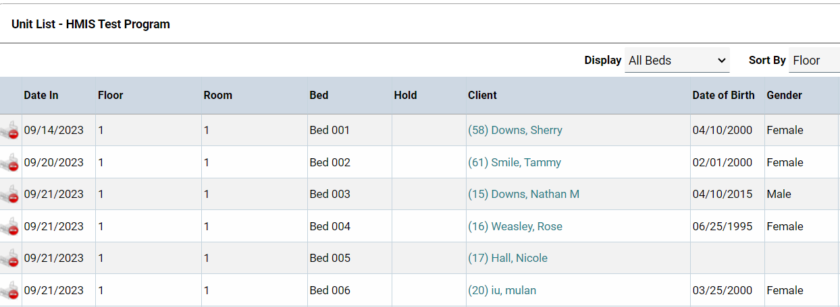
Express Check In
Unit List will be update with clients

Slide 43
Reminder
Entry assessment will need to be completed for all clients
HTTP://WWW.COMMUNITY-PARTNERSHIP.ORG/
5/17/2024

Slide 44
Interims
HTTP://WWW.COMMUNITY-PARTNERSHIP.ORG/
5/17/2024

Slide 45
THE CLIENT/HOUSEHOLD IS IN YOUR PROGRAM
Interims
Anything that happens after entry
Updates: general, non-time-specific changes
Annual Assessments: required to be entered within +/- 30 days of the Head of Household’s Entry Anniversary for all clients.
Updates and Annual Assessments have fewer questions to complete and/or update compared to the Entry Assessment.

Slide 46
CREATING AN INTERIM REVIEW

Slide 47
CREATING AN INTERIM REVIEW
5/17/202

Slide 48
INTERIM REVIEW ASSESSMENT
Interim review will depend upon the funding source of your program.
Review all information in the Interim Review to ensure it is still up-to-date. Make updates as needed.

Slide 49
DATA ELEMENTS COMMONLY UPDATED
HOUSING MOVE IN DATE
REQUIRED for Heads of Household in:
Permanent Supportive Housing
Rapid Rehousing
Other Permanent Housing
The Housing Move-in Date MAY be the
same date as the Entry Date
IF it is on the same date as the Entry Date you MAY enter it on the Entry Assessment.
If it is AFTER the Entry Date, you MUST enter it in an Update.
INCOME, NON-CASH BENEFITS, HEALTH INSURANCE
Sub-assessment has changed
Add an End Date to the information that is
no longer true, and then
Add a new line in the sub-assessment with
the new information.
Do not want to Delete any information that
used to be correct.

Slide 50
Case Manager
Case Plans
HTTP://WWW.COMMUNITY-PARTNERSHIP.ORG/
5/17/2024

Slide 51
THE HOUSEHOLD IS IN YOUR PROGRAM
Case Manager
used to indicate who is working
with the client
Case Plans
documents goal, actions and
case management notes
required for DHS and TCP funded programs

Slide 52
CASE MANAGER

Slide 53
Click “Add Case Manager”
Type
Community Services User
Me
Other
Complete the contact information
Click “Add Case Manager”
5/17/2024 66

Slide 54
There can be multiple Case Managers working with the client
When you are no longer working with the client – put an end date on your Case Manager section
HTTP://WWW.COMMUNITY-PARTNERSHIP.ORG/
5/17/2024

Slide 55
CASE PLANS

Slide 56
CASE PLANS
CLICK “ADD GOAL”

Slide 57
Complete all the fields in the Goal Pop-up box.
Case Manager
Date Goal was Set
Classification
Type
Goal Description
Overall Status
Once complete, click “Add Goal”
2

Slide 58
CASE NOTES
Adding Case Notes
Click “ Add Case Note”
Complete Case Note
Click “Save Case Note”

Slide 59
Action Steps
Smaller steps that lead to overall goal
Required for TCP/DHS funded programs

Slide 60
GOAL FOLLOW UPS
(Projected Follow Up Date) – date to follow up with client
(Follow Up User) – the person following up with client (Completed Follow Up Date) – date the follow up was made (Outcome at Follow Up) – outcome

Slide 61
ENDING A GOAL
(Overall Status) – In Progress or Closed
(If Closed, Outcome and Date Field) – Achieved, Partially Achieved, Not Achieved, Abandoned
(If Partially Complete, Percent Complete)
**Please note: Action Steps should be closed out on or before the date the goal they support is closed**

Slide 62
Service Transactions
HTTP://WWW.COMMUNITY-PARTNERSHIP.ORG/
5/17/2024

Slide 63
Service Transactions
Service Transactions are used to create services that are provided to the client.
Services or engagements should be logged throughout the client experience, from first contact through the duration of case management.
Service Transaction dashboard will allow you to
Add a Service
View Previous Service Transactions
View Shelter Stays
View the Entire Service History
**Services can be entered via Scans or on the individual client profile**

Slide 64
Service Transactions
Navigate to Services Transactions
Click “Add Service”

Slide 65
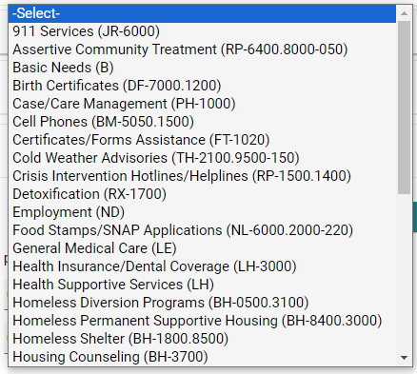
Service Transactions
Start date and end date automatically populate.
If you are completing the service the same day; then leave that information.
If the service will not be completed in the same day;
remove the end date by clicking the circle
Use drop down menu to select service
Click “Save & Continue”

Slide 66
Service Transactions
Complete any Service Notes
Keep notes clear, concise and relevant
Notes:
In the field labeled “Need Status” the status will automatically populate as “Identified”

Slide 67
Service Transactions
Scroll down
Need Status is automatically defaulted to Identified. Select the appropriate Need Status
• Identified – is a service that you have created (no end date)
• In Progress – is a service that you are actively working to provide or you have referred (no end date)
• Closed – is a service that you have completed (end date completed)
***Need information section is important for reporting***
CSON Providers: This is MANDATORY for documenting service progression and date of completion in order for DHS to track how long it takes for services to be fully resolved.
Notes:
In the field labeled “Need Status” the status will automatically populate as “Identified”

Slide 68
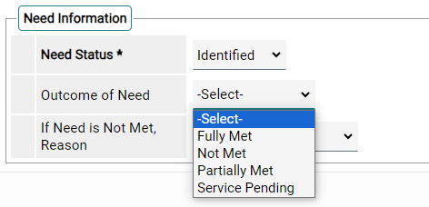
Service Transactions
If the Need Status is Closed;
Indicate the Outcome of Need
• Fully Met (end date)
• Not Met
• Partially Met
• Service Pending
Notes:
In the field labeled “Need Status” the status will automatically populate as “Identified”

Slide 69
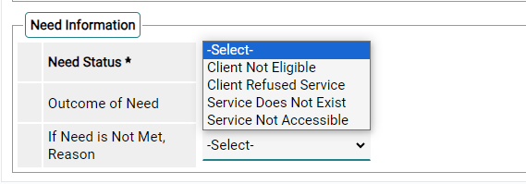
Service Transactions
If the Need is Not Met, select the reason
Notes:
In the field labeled “Need Status” the status will automatically populate as “Identified”

Slide 70
Exit
HTTP://WWW.COMMUNITY-PARTNERSHIP.ORG/
5/17/2024

Slide 71
HOUSEHOLD/ CLIENT LEAVES YOUR PROGRAM
Exiting a client
Create an exit for this client
Navigate to Shelter
Select the Unit List

Slide 72
Exiting a client
Find the correct client is the bed list
Click on the red minus button

Slide 73
Exiting a client
Make sure the correct client is selected.
Red minus button – to exit client

Slide 74
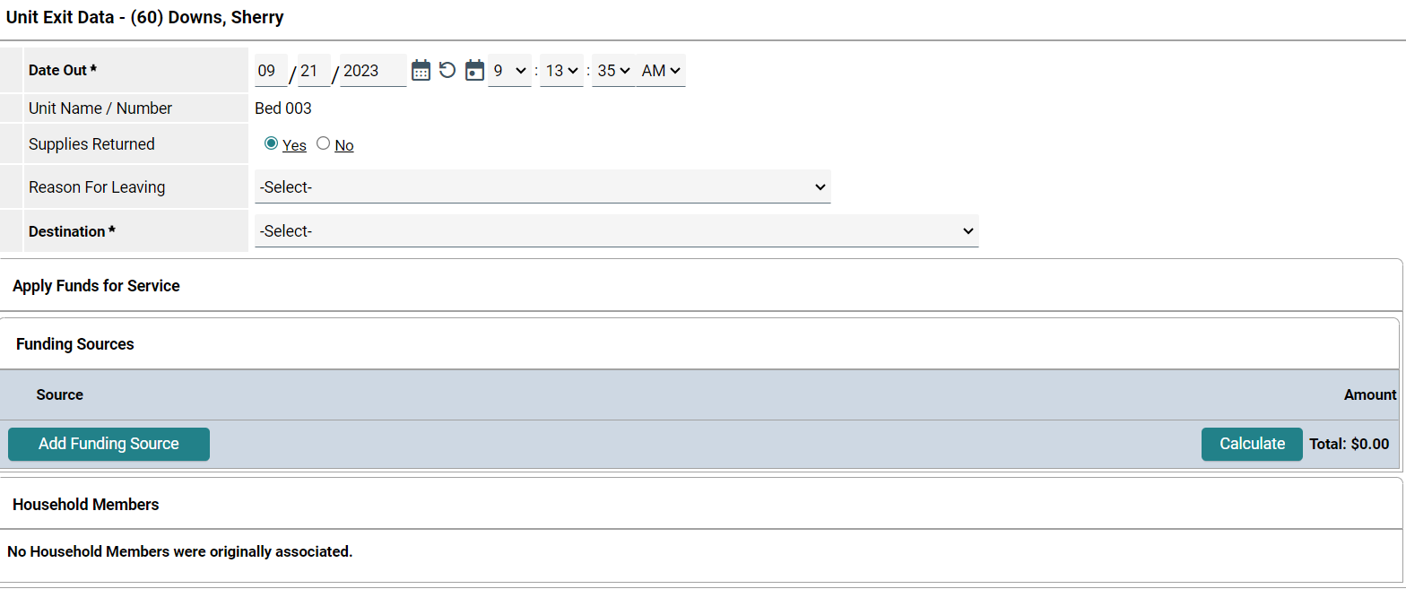
Make sure the exit date is correct
Complete the destination
Scroll down
Click Save & Exit

Slide 75
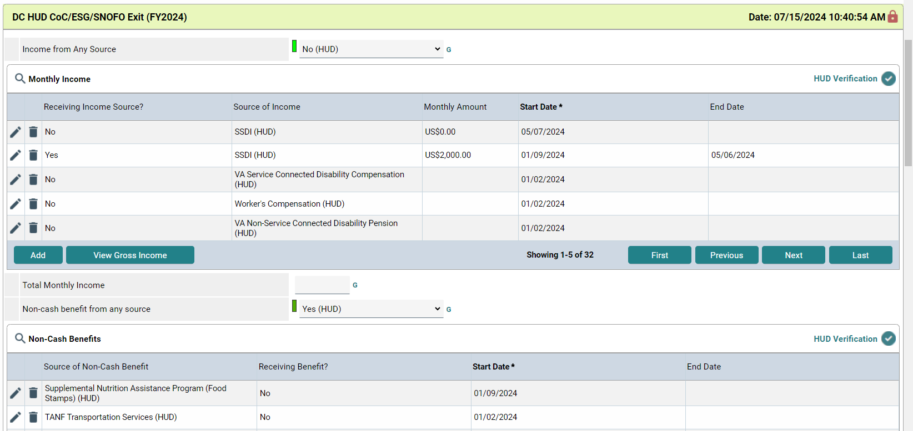
One client is exited while the others two are still in the program
The Exit Assessment allows you to update commonly updated fields
Depending on your program’s funding source, you may have additional questions at Exit
Be sure to read the assessment carefully to ensure you are answering all questions

Slide 76
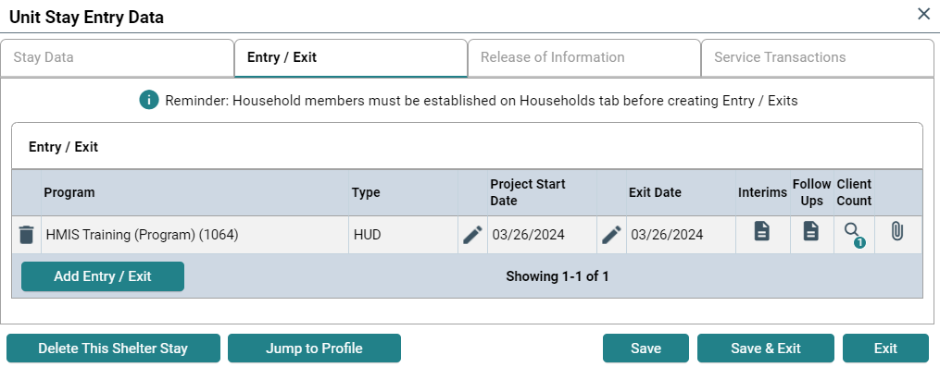
Exit Assessment = Entry/Exit
Once the Exit Assessment is complete, the client will have an entry on the Entry/Exit tab
This can be viewed by
clicking on the clients name, then tab to Entry/Exit
Or on the clients profile in Clients
The exit is system generated – make sure the exit destination is input correctly

Slide 77
Resources
HTTP://WWW.COMMUNITY-PARTNERSHIP.ORG/
5/17/2024

Slide 78
TCP WEBSITE/ HELPDESK
https://community-partnership.org
Contains:
Training registration links
Slide decks
User guides
hmis@community-partnership.org
Email the helpdesk with questions and we will provide answers and resources.
We respond within 2 business days.

Slide 79
Questions? HMIS Help-Desk Email: hmis@community-partnership.org

